Slide 1
Addressing domestic violence in your church
October 6, 2021
Recognize – Respond - Refer

Slide 2
Recognize

Slide 3
What is domestic violence?
Domestic violence is a pattern of coercion used by one person to exert power and control over another person in the context of a dating, family, or household relationship. This may include…
Actual or threatened physical harm
Psychological abuse
Forced sexual contact
Economic control
Social isolation
Destruction of property
Abuse of pets
Misuse of divine beings or religious beliefs, practices, teachings, and traditions
Asserting male superiority and attributing abusive behavior to cultural traditions
These behaviors can occur in any combination, sporadically, or chronically over a period of time.

Slide 4
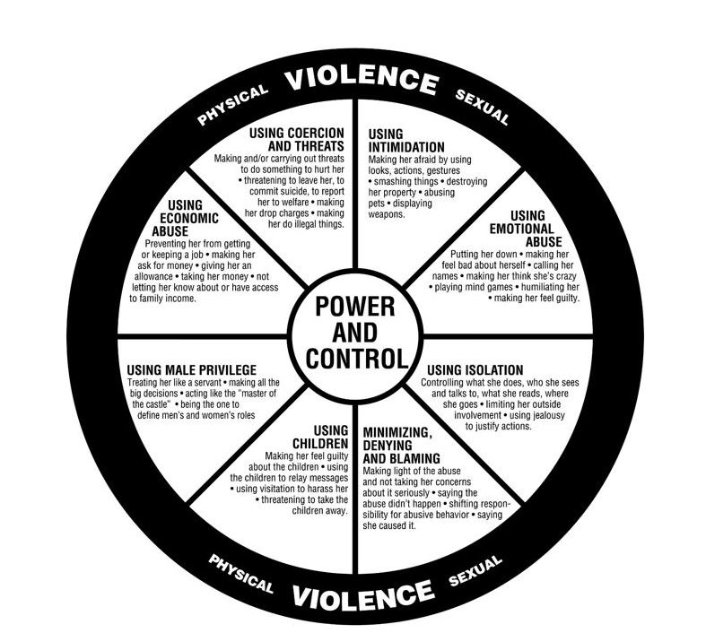
Domestic violence is a learned behavior and is NOT caused by:
Illness
Genetics
Alcohol and drugs
Out of control behavior
Anger
Stress
The victim’s behaviors or actions
Problems in the relationship
Children
Pets
Satan, demons, or other evil influences
There is NO excuse for domestic violence.

Slide 5
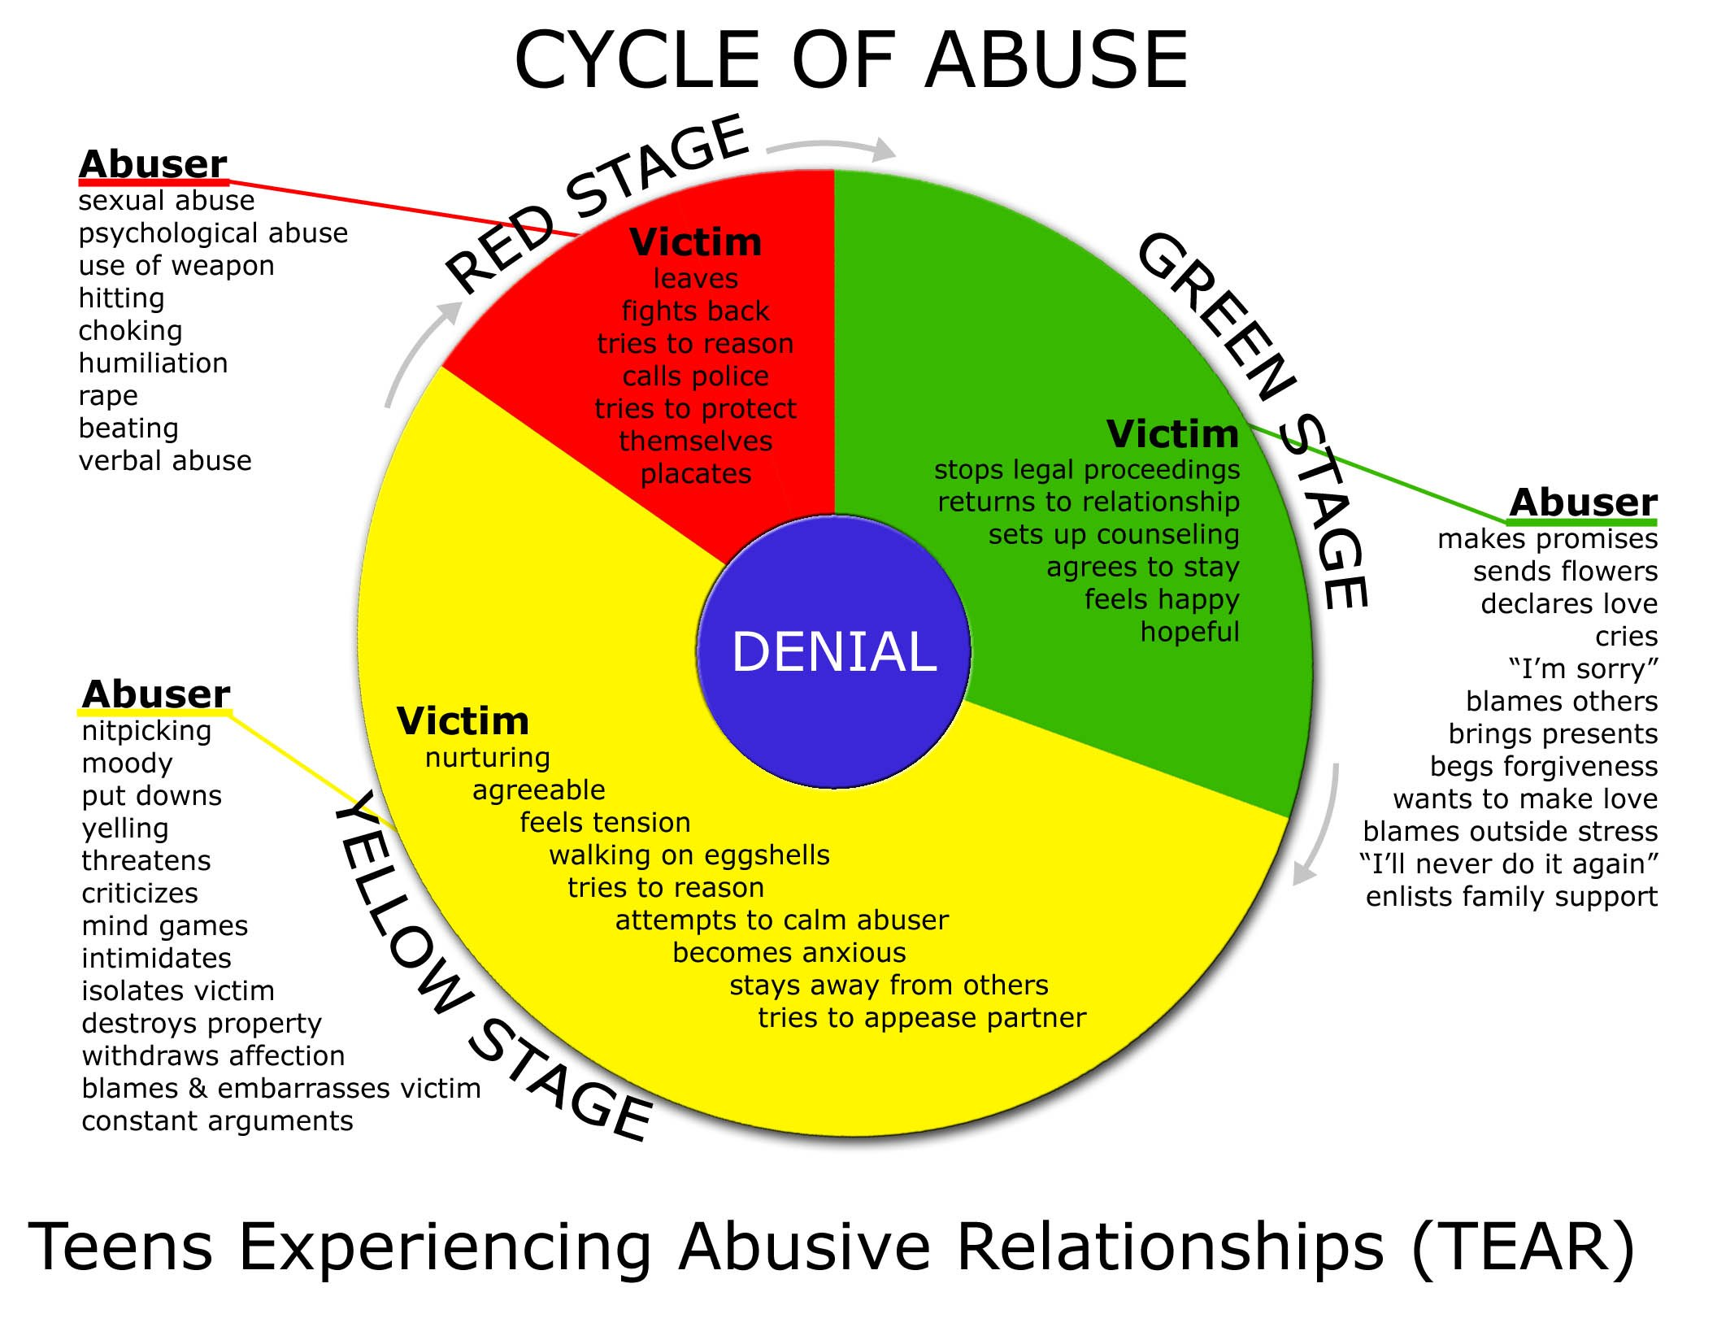

Slide 6
Obstacles to leaving
Fear
Economics
Social Isolation
Feelings of stigma, shame, and failure
Hopes and promises of change
Cultural messages
Prior lack of intervention
Lack of support
Children
In love with partner
Denial
Not feeling heard/believed

Slide 7
Characteristics of abusers
Risk factors for victims
There is no universal profile of an abuser. Perpetrators of domestic violence can be ANYONE. However abusers tend to:
Objectify their partners
Use power to get their way
Disregards partners feelings
Use coercion
Behave abusively with a particular victim
Usually well liked, not showing abusive behaviors in public setting
They will not acknowledge that their behavior is abusive or hurtful
Blames the victim, or other circumstances
Excessively possessive or jealous
Any person anywhere can be a victim of abuse. Domestic violence is more prevalent in certain groups which is:
Women
Teens
Pregnant women
Lack own financial access
Addicts, or whose partner is an addict
Watch for any dramatic changes in the victim’s normal behavior or routine, such as a sudden extended absence from church.

Slide 8
Children exposed to violence in the home
Observing or hearing violence can be as damaging to children as being abused themselves. Effects may include:
Difficulty in school
Exposure can affect their development as young as 6 months
Risk of harm when trying to intervene
Risk of continuing the cycle either as an abuser or victim
Confusion or anger regarding the violence occurring in their home
Self blame
Children like adults, may find it difficult to talk to anyone about the violence in their lives, turning them into “silent victims”.

Slide 9
Respond

Slide 10
Action steps – guiding principles
Safety – Assessment, assistance, and follow up must be conducted with concern for the victim’s safety.
Autonomy – Let the victim make their own choices and give them back any lost power.
Offender accountability – Don’t blame the victim.
Advocate for social change – Collaborate with other important community agencies and use your position to educate your congregation.

Slide 11
Starting the conversation
It is generally believed that survivors of domestic violence are more likely to disclose a history of abuse to their pastor or other religious leaders if the spiritual leader is perceived to be knowledgeable, non-judgmental, respectful, and supportive.
It is easiest to begin a conversation about domestic violence if posters, literature, sermons, discussion groups, or other congregation wide initiatives are already in place. (A list of suggestions is included in your handouts.)
No one should be asked about domestic violence unless the setting is private and the climate is respectful and confidential. Clergy and other spiritual leaders must first be well connected to service providers in their community.

Slide 12
What to say when you suspect abuse
Every couple has conflicts – what happens when you and your partner disagree? Do conflicts ever make you fearful or turn into physical fights?
Do you ever feel afraid of your partner?
I see congregants who are being hurt or threatened by someone they love. Is this happening to you?
Do you feel safe in your home and around your partner?
When I speak with someone with a situation/sadness/problem such as yours, it is sometimes because someone has hurt them. Has someone been hurting you?

Slide 13
What to say when a congregant discloses abuse
Would you like to speak with me or with someone else about what happened?
Is it safe for you to talk freely?
If you need help, I will help you find it.
Everything you tell me will be treated confidentially. (Remember to remind them of mandated reporting requirements.)
I will listen to what you say. I will believe what you tell me.
I will not press you to act. I will encourage and support you, but you are the one who knows best when and how to act.
God doesn’t hate you or want you to live this way. The God we believe in is a God of life and hope.
Additional script ideas are provided in your handouts.

Slide 14
Dos
Don’ts
Listen and believe
Communicate concern for safety
Assure confidentiality to the extent possible under the law
Make referrals
Convey ongoing concern and assure follow-up
Let the survivor set the pace for action and healing
Provide the survivor with appropriate texts or passages
Reassure the survivor that its not their fault
Ask why they haven’t left or why they returned to the abuser
Ask questions about abuse in the presence of the partner, friends, or family members
Tell the survivor what to do
React with disbelief, disgust, or anger
Recommend couples counseling (this can make abuse worse)
Encourage forgiveness
Do nothing
Blame them
Additional information is provided in your handouts.

Slide 15
What to say/do when a congregant discloses their abusive behavior
Keep safety for the possible victim, yourself, and your staff in mind while listening.
If the potential abuser claims the victim is responsible for the abuser’s actions, respond with opened ended statements such as, help me understand or tell me more.
Remain calm, level, and respectful at all times.
Ask the potential abuser if they are afraid of their partner, or if they have ever needed emergency help of any kind. (In general, most abusers reject the idea that they would be afraid, and deny any injury.)
Thank them for choosing to disclose to you, and refer them to Batters Intervention Programming. Offer to stand by as the initial call is made, support enrollment, and completion of the program.
Emphasize that you and your congregations belief that violence of any kind is always wrong, and your faith does not condone behavior of this sort.
Emphasize that it is the abuser’s responsibility, not the victims, to find a way to stop the violence behavior.
Do not offer or agree to provide couples, or marriage counseling.

Slide 16
Violence is always a choice By Lundy Bancroft
In most cases, perpetrators are capable of exercising control over their abusive actions, but choose not to do so for various reasons.
When an abusive man tells me that he became abusive because he lost control of himself, I ask him why he didn’t do something even worse. For example, I might say, “You called her a whore, you grabbed the phone out of her hand and whipped it across the room, and then you gave her a shove and she fell down. There she was at your feet where it would have been easy to kick her in the head. Now, you have just finished telling me that you were ‘totally out of control’ at the time, but you didn’t kick her. What stopped you?” And the client can always give me a reason. Here are some common explanations:
I wouldn’t do that. I would never do something like that to her. (Most frequent response.)
I was afraid someone would call the police.
I could kill her if I did that.
The fight was getting loud, and I was afraid of the neighbors would hear
These answers don’t support their loss of control excuse.

Slide 17
Things to keep in mind
The danger for the survivor increases when they disclose abuse to others, or attempt to leave.
Your role is to support the survivors decision, even if you don’t agree with it.
Encourage but do not force a survivor to call the police or Pearl.
Abusers often search their victim’s belongings. Before giving any materials to the victim, ask if they feel safe to take them.
Be mindful of biblical texts or passages that may support the abuse. (A list is provided in your handouts.)
Always remember, it is possible that a person can be kind to you, that you like them, and they are still an abuser.
Be sure your office, and place of worship has a safety plan.
Do you have a plan for when the abuser shows up?
Is there a way to lock the doors, and quickly summon help from law enforcement?
If you are alone in the building, do you keep the doors locked? Or have a way to be safe from unexpected intruders?
Do you have a way to screen callers, and visitors before they enter?
Create a safety plan with your staff addressing emergency response and crowd control.

Slide 18
Refer
When making referrals keep in mind the safety and wellbeing of ALL effected by the violence. (Victim, Children, Family, Friends, and Abuser)

