Slide 1
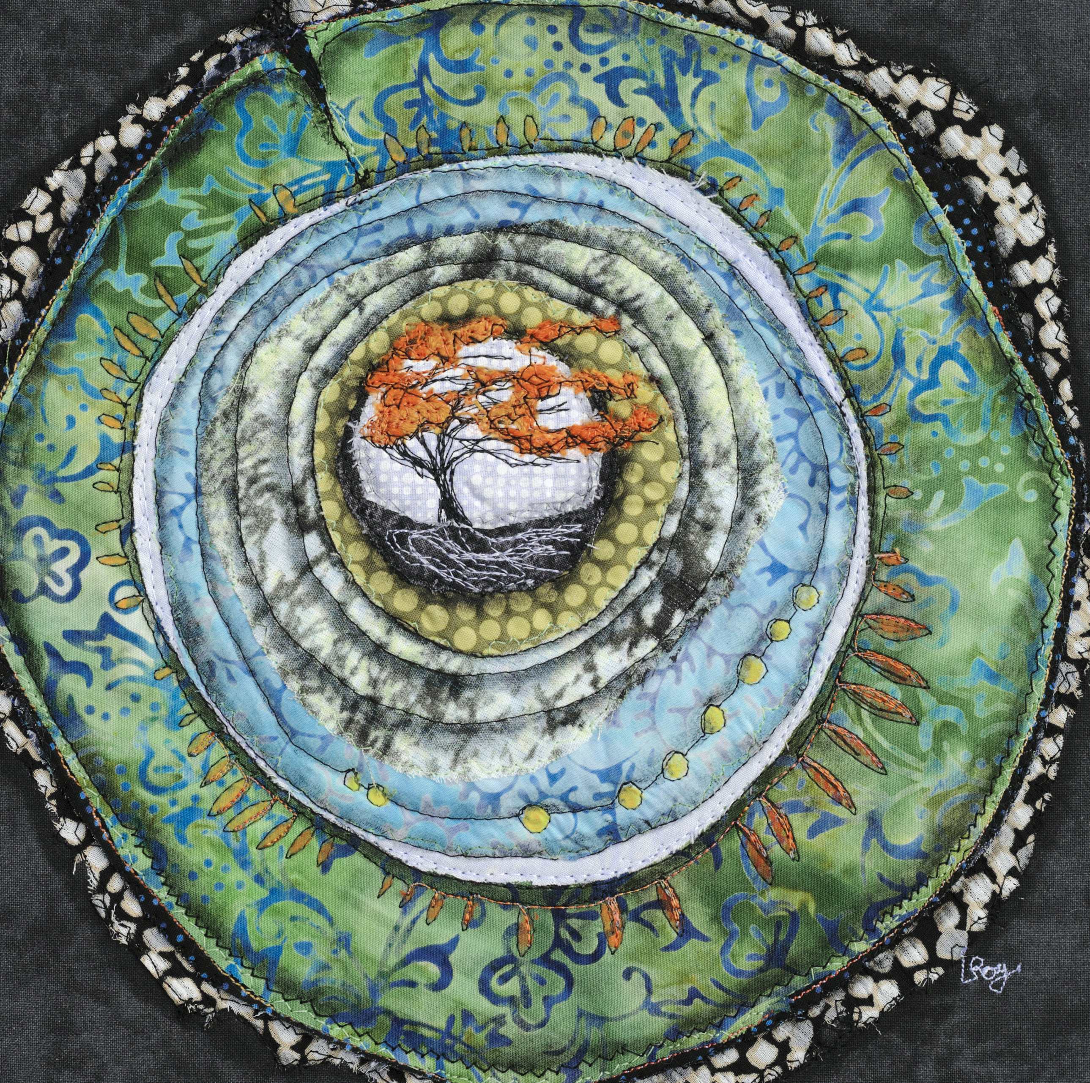
Safe Church Basics
Five Steps to a Safer Church
Assess Risk
Make/Revise Policy
Screen and Train Leaders and Volunteers
Practice Being Restorative
Respond to Abuse with Justice and Compassion

