Slide 1
Notes:
Photo by Jonas Von Werne from Pexels

Slide 2
Words of Introduction
Notes:
Photo by Jonas Von Werne from Pexels

Slide 3
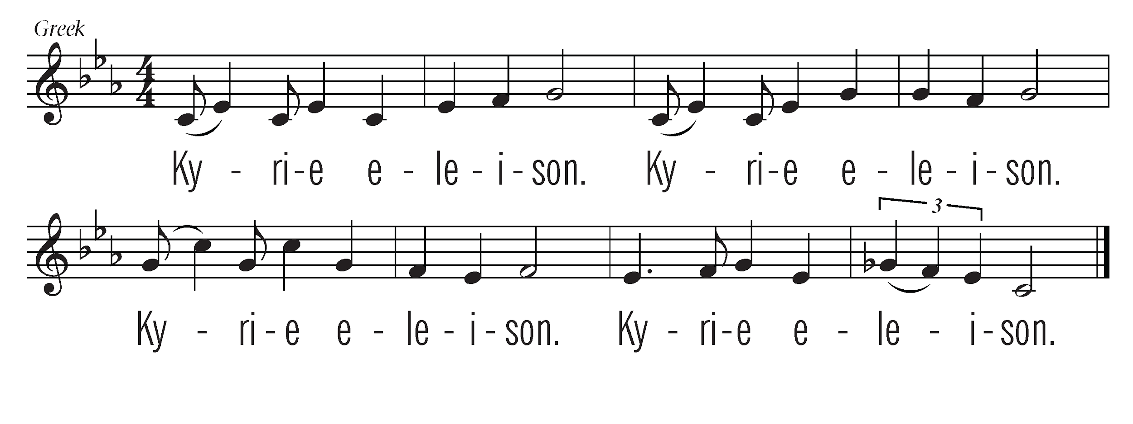
Leader 1: We came with our stories,
and no one heard,
Leader 2: because you did not know
how to listen.
All Sing:
Notes:
Photo by Jonas Von Werne from Pexels

Slide 4
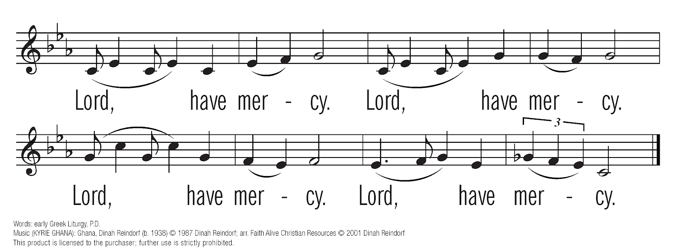
Leader 1: We came with our wounds,
and no one noticed,
Leader 2: because you could not
see past your loyalty.
Notes:
Photo by Jonas Von Werne from Pexels

Slide 5
Leader 1: We came with our courage,
and no one recognized it,
Leader 2: because you were not
ready to receive our truths.
Notes:
Photo by Jonas Von Werne from Pexels

Slide 6
Leader 1: We came with our witness,
and no one opened
their hearts to us,
Leader 2: because you could not believe
it would happen here.
Notes:
Photo by Jonas Von Werne from Pexels

Slide 7
Leader 1: We came with our stories,
and the silence was deafening,
Leader 2: because there was no way
for us to be restored.
You are invited to bring forward your own stone as a witness to your story or the story of someone you know.
Notes:
Photo by Jonas Von Werne from Pexels

Slide 8
Notes:
Photo by Jonas Von Werne from Pexels

Slide 9
Leader 1: We join with the Psalmist in
crying out: “I am poured out
like water and all my bones are out of joint.” (Psalm 22:14a)
Leader 2: Those who were supposed to
care for me used their power
to hurt me.
All: For the breaching of
relationships and the abuse
of sacred trust, we cry out.
Notes:
Photo by Jonas Von Werne from Pexels

Slide 10
Leader 1: “My heart is like wax;
it is melted within my breast;” (Psalm 22:14b)
Leader 2: I no longer felt safe in the place
where I was supposed to
experience God’s love.
All: For the loss of spiritual home,
church family, and holy ground,
we lament.
Notes:
Photo by Jonas Von Werne from Pexels

Slide 11
Leader 1: “My mouth is dried up like a
potsherd, and my tongue sticks
to my jaws; you lay me in the
dust of death.” (Psalm 22:15)
Leader 2: Every step of the way I had to
fight to be heard and
understood.
All: For systems and structures
that retraumatize survivors,
we wail.
Notes:
Photo by Jonas Von Werne from Pexels

Slide 12
Leader 1: “My hands and feet have
shriveled; I can count all my
bones.” (Psalm 22:16b, 17a)
Leader 2: The abuse of power I
experienced impacts my life,
my work, and my relationships.
All: For the trauma that lives in
flesh and bones, for the
wounds that surface and
resurface, we grieve.
Notes:
Photo by Jonas Von Werne from Pexels

Slide 13
Leader 1: “I am a worm, and not human;
scorned by others, and
despised by the people.”
(Psalm 22:6)
Leader 2: When I told my story,
the community turned its back
on me.
All: For the failure to hear, believe,
and take action in response
to reports of abuse, we weep.
Notes:
Photo by Jonas Von Werne from Pexels

Slide 14
Leader 1: “O my God, I cry by day, but
you do not answer; and by
night, but find no rest.” (Psalm 22:2)
Leader 2: Because of what happened to
me, I have struggled to hold on
to my faith.
All: For the effects of abuse that go
beyond the capacity of words
to capture, for all that is lost,
we mourn.
Notes:
Photo by Jonas Von Werne from Pexels

Slide 15
Leader 3: “Yet you, O God, are holy,
enthroned on the praises of
your people. In you our
ancestors trusted; they trusted,
and you delivered them.
(Psalm 22:3-4)
So “I will tell of your name to
my brothers and sisters; in the
midst of the congregation I will
praise you:” (Psalm 22:22)
Notes:
Photo by Jonas Von Werne from Pexels

Slide 16
Leader 3: “For you did not despise or
abhor the affliction of the
afflicted; you did not hide your
face from me, but heard when I
cried out.” (Psalm 22:24)
Notes:
Photo by Jonas Von Werne from Pexels

Slide 17
Leader 1: We came with our stories,
and they were honored,
Leader 2: because you heard in them a
prophetic voice speaking the
truth in love.
All: As disciples of Christ,
we commit to following
his way of listening to the outcast and the voiceless.
Notes:
Photo by Jonas Von Werne from Pexels

Slide 18
Leader 1: We came with our wounds,
and they were healed,
Leader 2: because you reached out
with compassion.
All: As followers of Jesus,
we commit to continuing
his ministries of healing
and restoration.
Notes:
Photo by Jonas Von Werne from Pexels

Slide 19
Leader 1: We came with our courage,
and it was celebrated,
Leader 2: because you saw in each one
the radiant image of God.
All: As people of God, we commit
to holding those in power
accountable to use it wisely
and well.
Notes:
Photo by Jonas Von Werne from Pexels

Slide 20
Leader 1: We came with our witness,
and hearts were opened to us,
Leader 2: because you honored your
responsibility to one another.
All: As the Body of Christ,
we commit to standing
together in solidarity
with those who suffer,
as members of one body committed to God’s love
and justice.
Notes:
Photo by Jonas Von Werne from Pexels

Slide 21
Leader 1: We came with our stories,
and they were heard,
Leader 2: because we learned to listen
to what the stones
are crying out.
All: Thanks be to God,
who showed us in Christ Jesus
a new kind of power;
Notes:
Photo by Jonas Von Werne from Pexels

Slide 22
the power to serve, to love,
to listen, to heal,
and to transform the world.
To this right use of power,
to this way of being in just
and loving relationship,
to this manifestation of grace,
to this vision of shalom,
we commit our hearts,
our hands, and our Church.
Notes:
Photo by Jonas Von Werne from Pexels

Slide 23
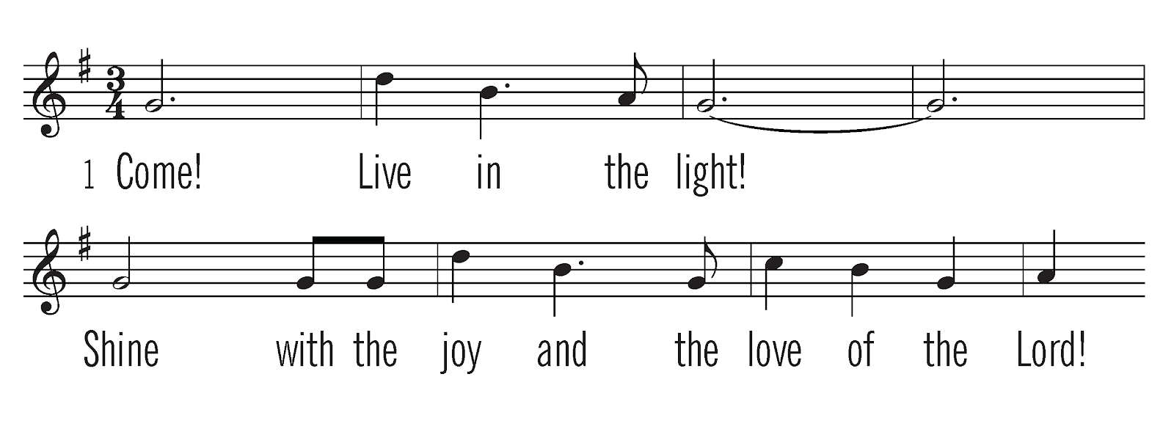
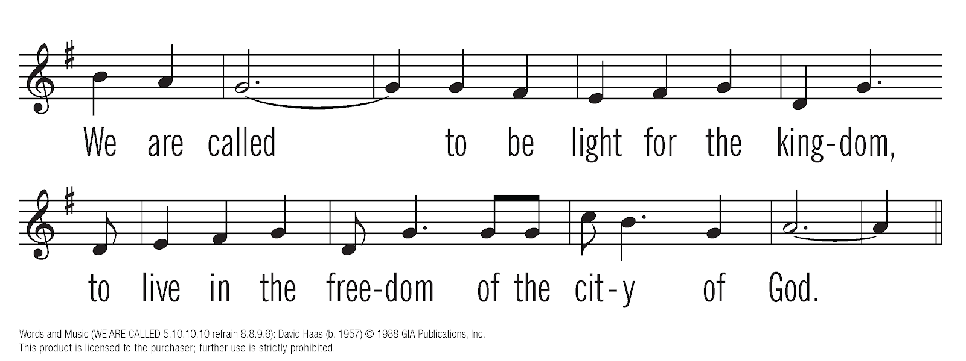
Notes:
Photo by Jonas Von Werne from Pexels

Slide 24
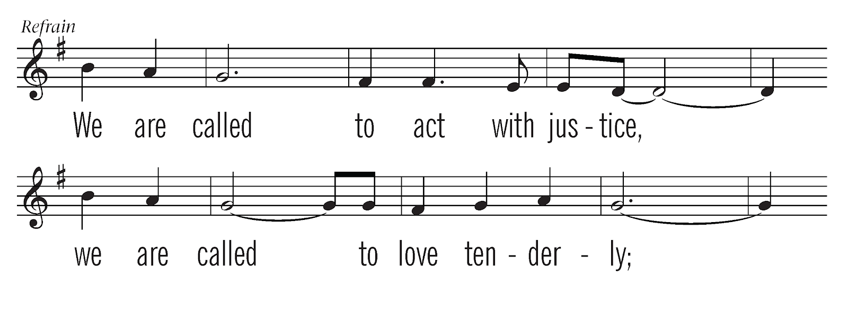
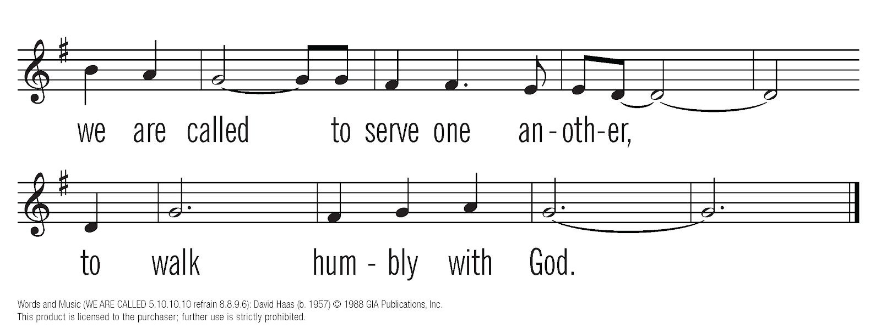
Notes:
Photo by Jonas Von Werne from Pexels

Slide 25
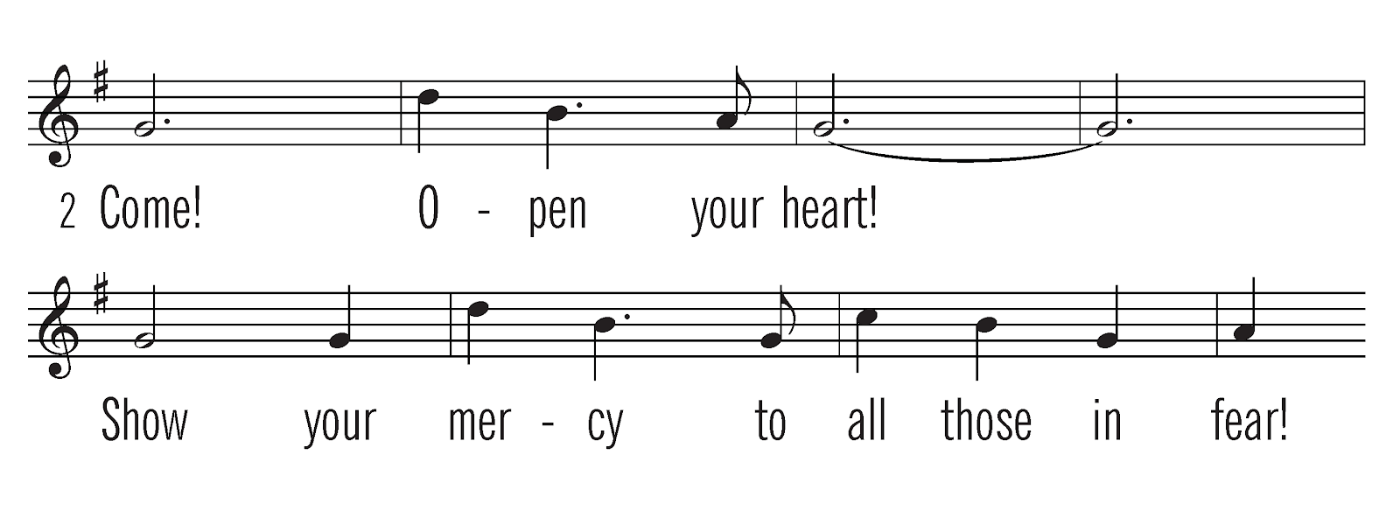
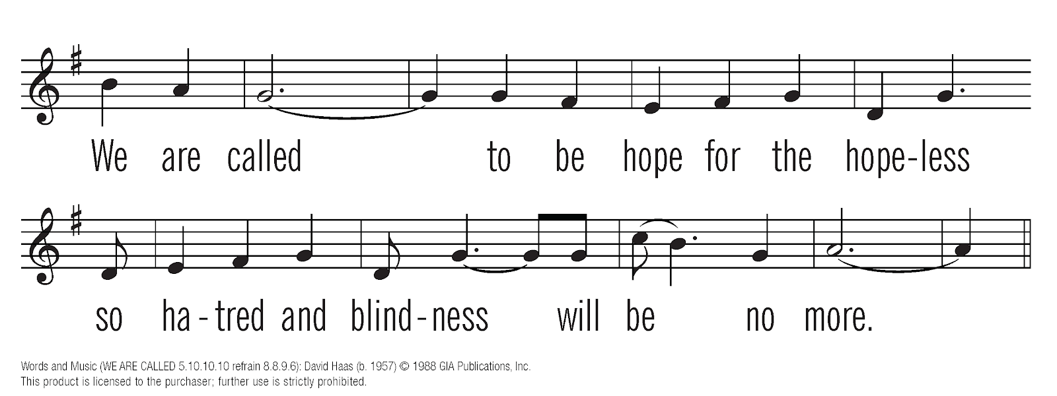
Notes:
Photo by Jonas Von Werne from Pexels

Slide 26
Notes:
Photo by Jonas Von Werne from Pexels

Slide 27
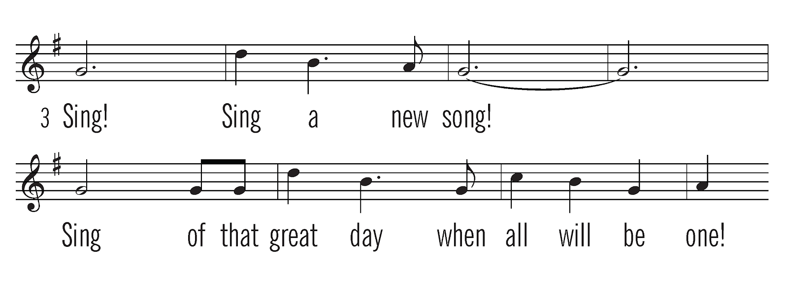
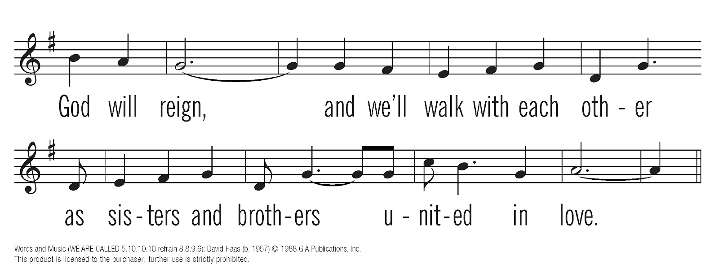
Notes:
Photo by Jonas Von Werne from Pexels

Slide 28
Notes:
Photo by Jonas Von Werne from Pexels

Slide 29
This liturgy was written by Sharon R. Fennema Ph.D.
Kyrie/Lord, Have Mercy
Words: early Greek Liturgy, P.D.
Music: Ghana, Dinah Reindorf (b. 1938); arr. Faith Alive Christian Resources © 2001 Dinah Reindorf CCLI #397396
We Are Called
Words and Music: David Hass © 1988 GIA Publications, Inc.
One License #A-717740
Photo by Jonas Von Werne from Pexels
Notes:
Photo by Jonas Von Werne from Pexels

