Slide 1
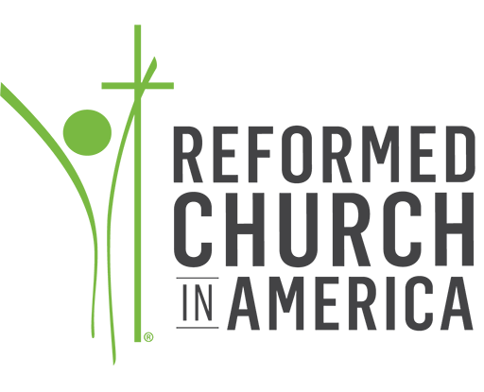
2018 Worship Survey
CRCNA Results
Notes:
Grateful for the support of CICW which made this survey possible. It was a collaboration between CICW, CRC Wmin, and the RCA Commission on Worship.
This survey was overseen by the Center for Social Research at Calvin College and they told us that any response rate over 20% is adequate to be representative of the audience surveyed. We had a 30% rate of CRC churches with a balanced representation of CRC and US churches. So we can confidently consider these stats valid but the further we drill down (we could give data for specific classis for example) the less certain we can be of the stats.

Slide 2
Worship Statistics
Word: Reading and Preaching
Baptism and Profession of Faith
Lord’s Supper
Public Prayer
Other Liturgical Elements and Practices
Worship Formation
Worship Leadership
Worship Planning Process
Music and Congregational Song
Worship Space
Technology
Demographics
Specific CRC Questions
Notes:
A lot of topics are covered in this survey as you can see here. In order for us to get through all of them we won’t spend time on all the questions but focus on areas that I think there would be the most interest and the most to learn. We invite you to write your questions/observations in the chat box and then we will pause throughout to address them.

Slide 3
Worship Statistics
CRCNA Results

Slide 4
 | 1999 | 2018
How many churches have 2 services on Sunday? | 73.5 | 37
Notes:
I was surprised to see that there is a higher percentage of churches in the US with 2 or more unique services in a week than in Canada.
The last worship survey we did was in 1999 and this is one question that was asked back then. You can see that in 1999 73.5% of churches had 2 services while today taking the US and Canada together only 37% of churches do.
In most instances there is not a big difference between churches in Canada and the United States. Where there are interesting differences to note I will differentiate between the two countries. In future surveys it may be interesting to ask churches to select if they are rural, urban, or sub-urban and do some data analysis that way. I have a suspicion that we will see greater differences between rural and urban churches for example than we do between Canadian and US churches in general.

Slide 5
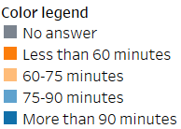
Notes:
Most of our services are just over an hour long. And while there is little difference between the US and Canada we see a greater difference between organized and emerging churches and between churches of differing ethnic or racial make up.
I think it is important for us to take a look at what is happening in the emerging church because they are the organized church of the future. It is also important to look at what is happening in ethnic minority churches because they are the growing edge of our denomination.
This particular question is important because it deals with “time” and who is it that gets to determine a communities understanding of and approach to time.

Slide 6
 | 1999 | 2018
Average Attendance: 0-99 | 17.6 | 32
Notes:
Churches continue to get smaller as can be seen when we compare how many churches had an average attendance of less than 99 people in 1999 with today.
Many of these smaller churches have less resources available to them in the way of staff, volunteers, and finances. What does worship look like when you don’t have as members or the budget to hire musicians?

Slide 7
Word: Reading and Preaching
CRCNA Results

Slide 8
 | 1999 | 2018
Number of Scripture passages read One Two | 79.5 | 65
 | 20.5 | 19
Notes:
What is confounding in this slide is that 2% of our churches in the US and Canada claim that they don’t read any scripture ahead of the sermon.
What is also interesting is that drop in churches that read one passage from 1999 to 2018. Can we intuit that there are more churches reading 3 or more passages today than in 1999?

Slide 9
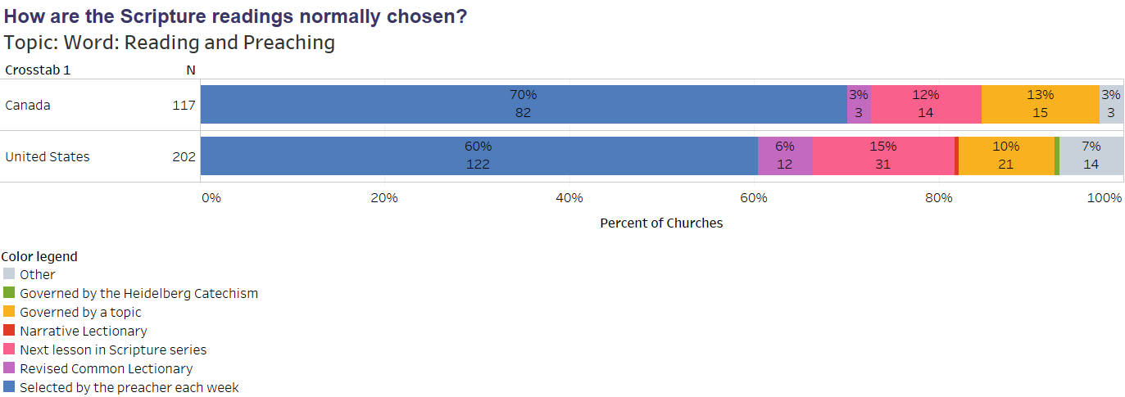
 | 1999 | 2018
Usage of Revised Common Lectionary Always Sometimes | 6.8 | 5
 | 31.5
Notes:
It is interesting to note that the RCL usage has gone down since 1999.
HC preaching is just a blip on the US chart…but since folks were asked to respond on the basis of only one of their services the second service didn’t play into this and that is often where Catechetical preaching happens. In hindsight we should have added the question of how often does your pastor preach on the HC in any of their services.

Slide 10
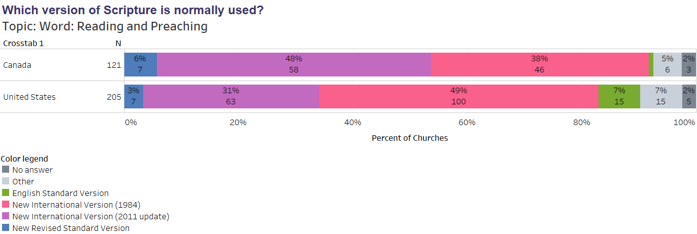
 | 1999 | 2018
Scripture Version NIV NRSV | 91.8 | 82
 | 1.5 | 4
Notes:
The Common English Bible and the King James Version were also on the list but they were not chosen by anyone so they don’t appear on the results.
You can see that since 1999 the use of the NIV (either edition) has gone down while the use of the NRSV has gone up.

Slide 11
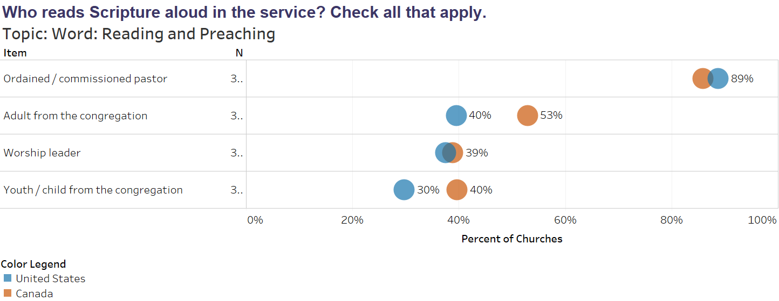
Notes:
By the end of the survey it will become clear that Canadian churches utilize more lay people and seem to be more creative in their worship than churches in the US.

Slide 12
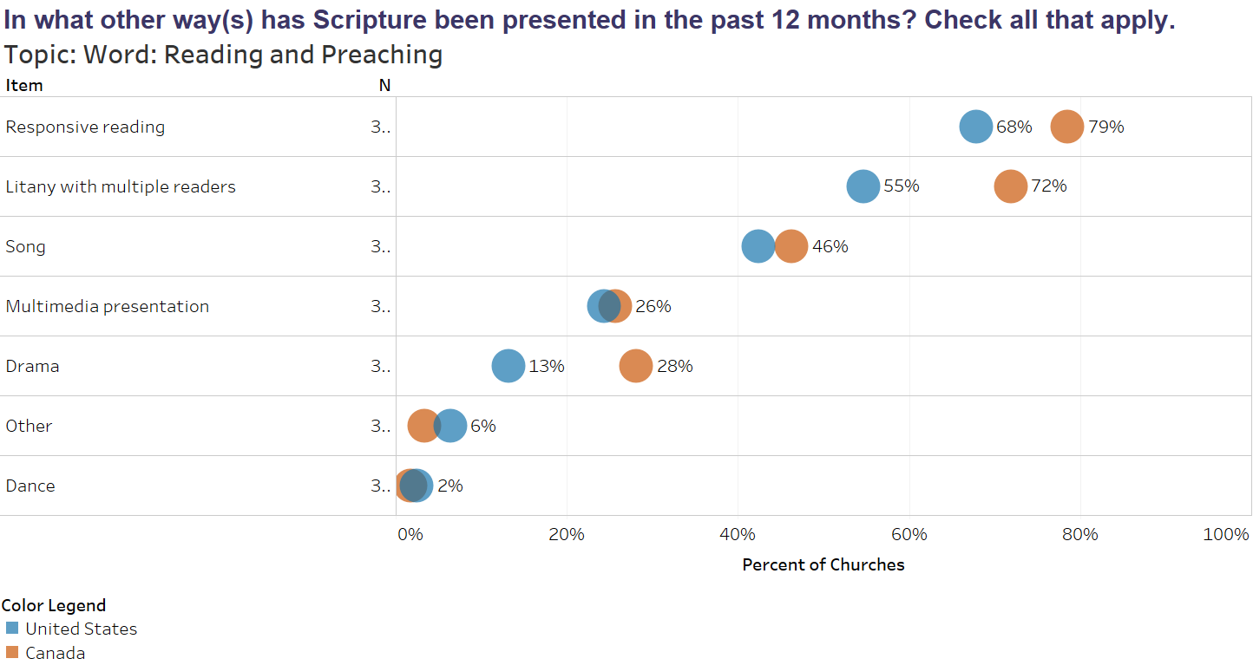
 | 1999 | 2018
Scripture presentation: Litany with multiple readers Drama | 47 | 61
 | 38 | 19
Notes:
Again, note the difference between the US and Canada. It is also interesting to note that we are using more litanies and less dramas than we were in 1999. In part, this may be because we are rediscovering the drama inherent in worship and highlighting the drama that already exists in scripture.

Slide 13
 | 1999 | 2018
Have a Children’s Message/Sermon | 54.5 | 50
Notes:
Not much variation with children’s messages from 1999 nor between the US and Canada.

Slide 14
Notes:
Sermon prep time… the number of preachers spending less than 5 hours prepping was surprising. We checked to see who answered this question, worship leaders, or the preachers themselves and it was the preachers. But notice what happens when we compare organized vs. emerging. 16% of emerging church pastors spend less than 5 hours on sermon prep. Given the various demands on their time and the fact that many are bi-vocational this shouldn’t be a surprise.
But is it possible to prepare a good sermon in less than 5 hours? Frankly, I wonder how much time the Apostles spent preparing? Of course we aren’t them either. Does the HS make up the difference regardless? Does this help or impede the gospel message? What would be most helpful to support pastors with sermon planning when they have so few hours available for prep?

Slide 15
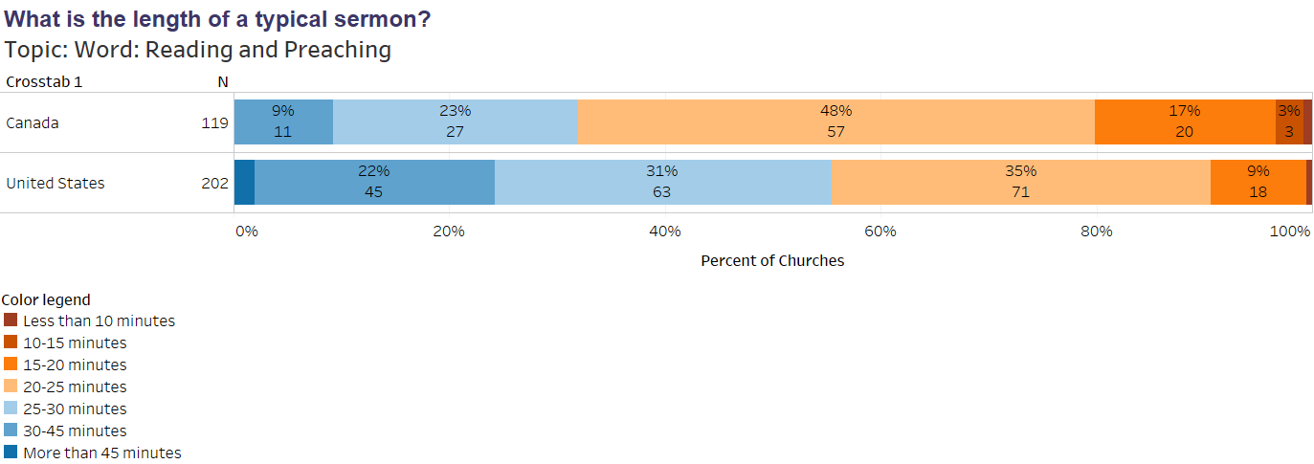
Notes:
What I find interesting here is that sermons in churches who are of a predominantly non-white race or ethnicity have both the shortest sermons of less than 10 minutes and the longest of more than 45. In general though you are going to hear longer sermons in the US than Canada.

Slide 16
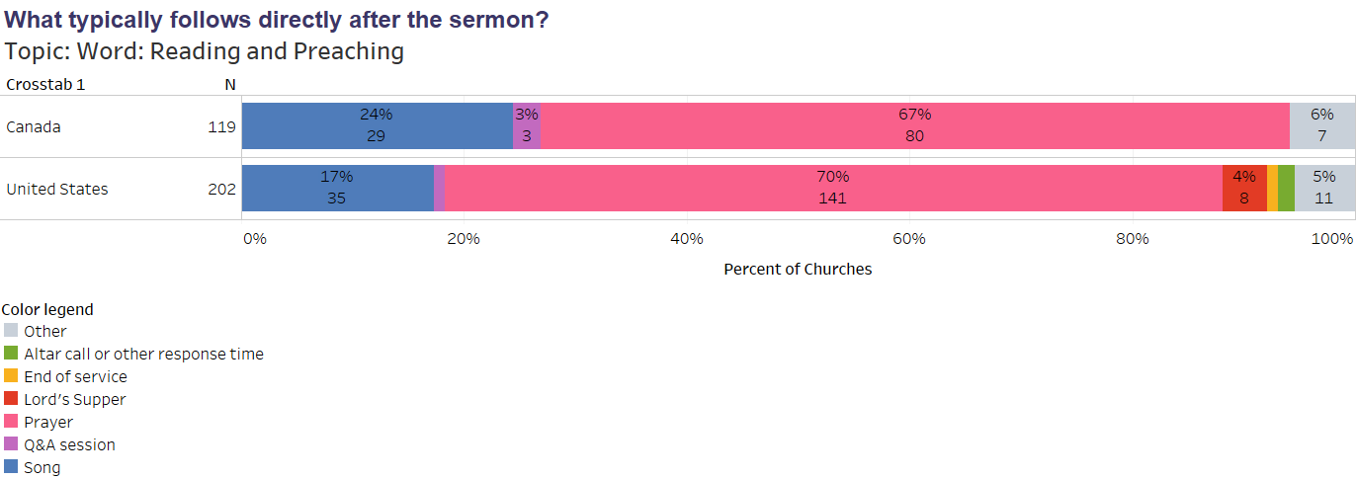
Notes:
This is an interesting question to watch. The CRC liturgy has traditionally had a prayer and song directly following after the sermon. It will be interesting to see if over time that that will decrease either from churches who simply end worship following the message to those who deliberately leave room in the service for responding to the sermon through a time of personal reflection and/or the opportunity to seek out prayer. I few years ago I was working on a multi-ethnic worship service with a Korean, Latino, and African-American and all 3 indicated that the response time following the sermon was the most significant part of the service for their ethnic group.

Slide 17
2018 Worship Survey
CRCNA Results
Notes:
Questions?

Slide 18
Baptism and Profession of Faith
CRCNA Results

Slide 19
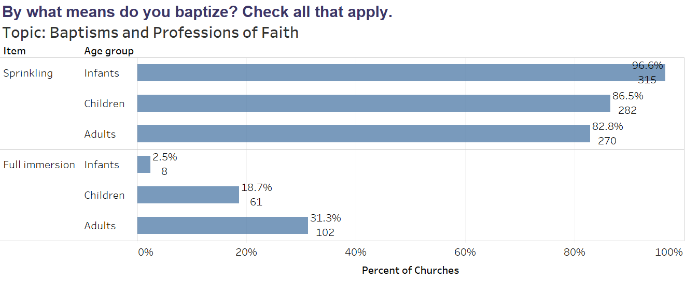
Notes:
I’m guessing that if we were to ask this question again in 5-10 years we would see an increase in the number of churches allowing for immersion.

Slide 20
 | 1999 | 2018
Baptismal liturgy Yes Yes, but adapted No | 41 | 33
 | 41.8 | 57
 | 15.7 | 2
Notes:
Denominational baptismal liturgies still are used or adapted by the great majority of our churches.

Slide 21
Notes:
To help our congregants understand that baptism is not a “once and done” event but that it has implications for how we live as God’s children some churches have begun to connect baptism to other liturgical acts like confession and forgiveness for example.

Slide 22
Notes:
Again, this is something we want to be paying attention to especially given that almost 50% of emerging churches will allow for dedication. Remember that dedication is not a sacrament and not treated as such in these cases, nor does it mean that these churches do not teach a Reformed theology of infant baptism. This issue has already been discussed at the classis level and I wonder if the larger denomination needs to listen to how those classis wrestled with the issue and what conclusions they came with and then determine if we need a common approach as a denomination and what that may be. How do we balance the desire to be hospitable and welcoming to those of varying beliefs while still being Reformed. Is it possible?

Slide 23
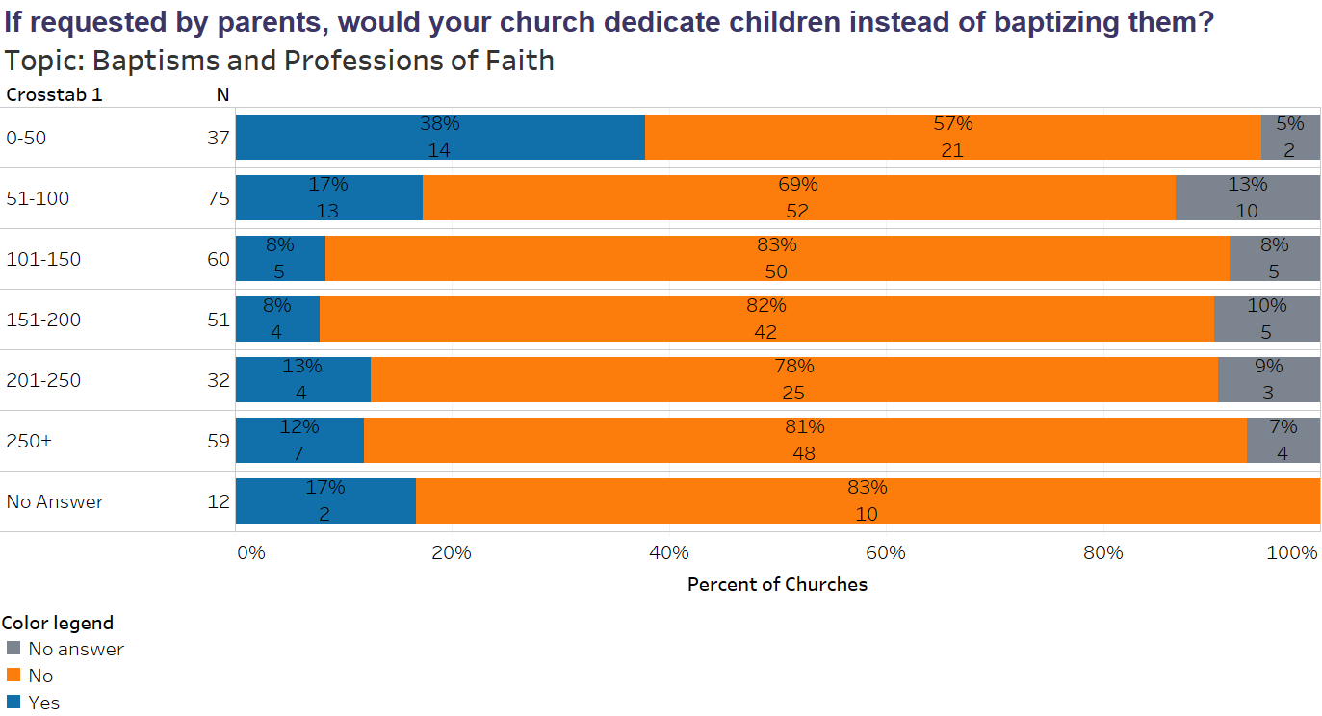
Notes:
In this slide we ask the same question but see the answer based on church size. Not surprisingly dedication is allowed more often in smaller churches given that it is happening in more emerging churches.

Slide 24
Notes:
We’ve never asked this question before so I don’t know if it is a practice that is increasing in the CRC or not, but I’m guessing it is. Again it may be something that may be worth having a conversation about so that we can learn from each other about how best to deal with such requests and how we might frame their role in a CRC context.

Slide 25
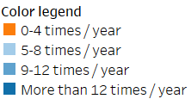
How often does your church typically celebrate a formal first-time profession of faith for one or more individuals?
Notes:
Again this will tell us more if we ask the same question again in a few years to see if there are any trends.

Slide 26
 | 1999 | 2018
Profession of Faith Liturgy Yes Yes, but adapted No | 55 | 37
 | 32.6 | 52
 | 0.7 | 3
Notes:
Denominational liturgies are still being used but more frequently adapted.

Slide 27
2018 Worship Survey
CRCNA Results
Notes:
Questions?

Slide 28
Lord’s Supper
CRCNA Results

Slide 29
 | 1999 | 2018
Frequency of the Lord’s Supper Weekly 1-2x/month 1-2x/quarter | 0.5 | 4
 | 23 | 40
 | 54.5 | 39
Notes:
We can see that churches are celebrating the Lord’s Supper more often today than they were in 1999. But what is fascintating is that among the churches that most often practice weekly communion are emerging and multi-ethnic churches.

Slide 30
 | 1999 | 2018
Use of Preparatory form | 59.6 | 52
Notes:
Intentional preparation the week ahead of the LS is happening in just over 50% of our churches. A little more than a 7% drop since 1999.

Slide 31
 | 1999 | 2018
Lord’s Supper Liturgy Yes Yes, but adapted Create our own No | 32 | 23
 | 48.5 | 56
 | 17.7 | 15
 | 0.5 | 4
Notes:
LS liturgies are still being used either as they are or adapted in most churches including emerging churches. Though emerging churches are also most likely to create their own form or not use one at all.
Smaller churches are also more likely to create their own liturgies.

Slide 32
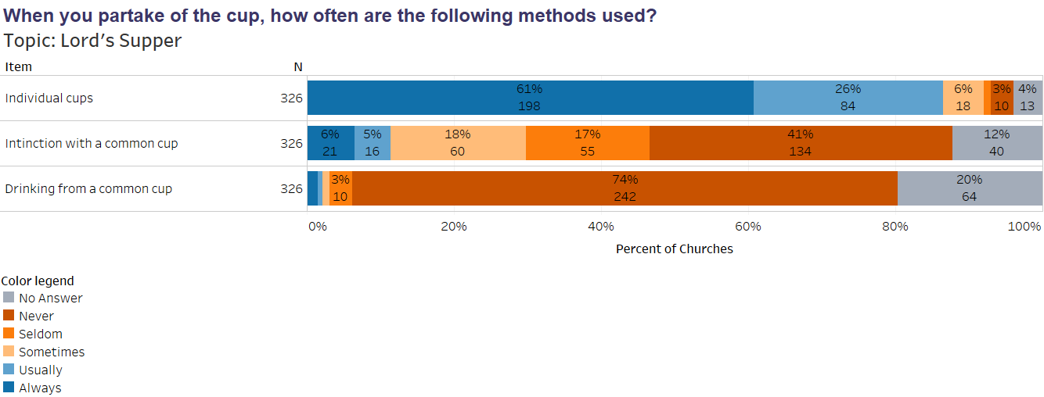
Notes:
I guess I was a little surprised to learn that 61% of our churches always use the individual cups for communion. But it looks like most of our congregations do on occasion also dip bread into a cup (intinction). Not surprisingly we don’t seem to have any users of a common cup.

Slide 33
Notes:
Most of our congregations only use grape juice.

Slide 34
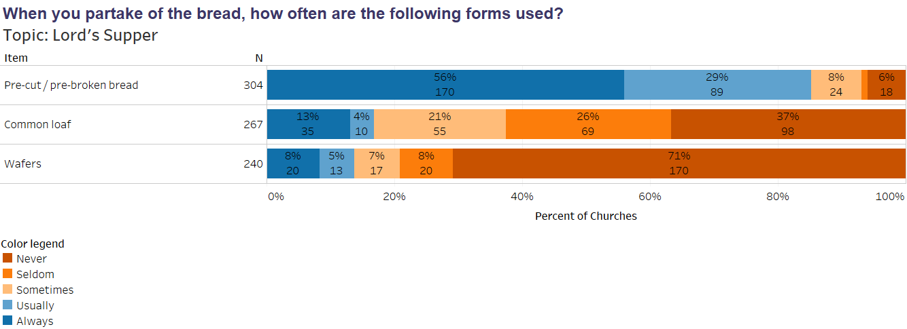
Notes:
And there seems to be a mix of the type of bread used.

Slide 35
Notes:
Given the number of individuals that have food allergies in our culture today I was a little surprised to learn that there are still a significant number of our churches that do not provide any options for these individuals to participate.

Slide 36
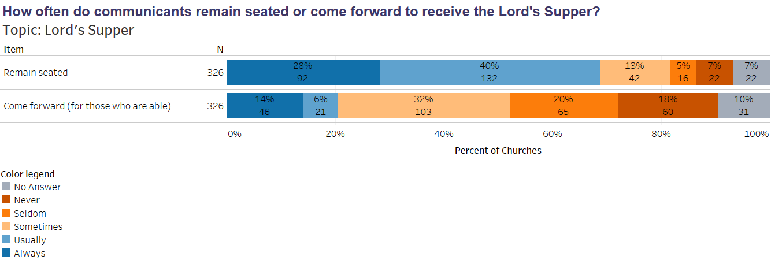
 | 1999 | 2018
Do communicants typically remain seated or come forward? Seated Come forward Sometimes come forward | 67.5 | 68
 | 40 | 20
 |  | 32
Notes:
There doesn’t seem to be much movement among churches choosing to come forward over remaining in the pew for communion compared to 1999.

Slide 37
Notes:
I’m guessing if we had data from 1999 on this question we would find that the LS table is more open than it has been in the past. I was a little surprised at the number of churches where anyone is allowed to participate. But I wonder if we shouldn’t have added a category, “All who profess Jesus as their Lord and Savior” rather than assume that those individuals would be included in the “Baptized” category.

Slide 38
Which prevailing theme(s) are communicated during your congregation’s celebration of the Lord’s Supper? Check all that apply.
Notes:
This question may give us pause to consider whether or not we are teaching our congregants a full understanding of the Lord’s Supper. While we could pull out many additional themes I think Remembrance, Communion, and Hope offer a good summary of the meaning of the LS. How might a greater emphasis on how the LS provides us with Hope be helpful pastorally given a world that is increasingly divided and filled with fear?

Slide 39
2018 Worship Survey
CRCNA Results
Notes:
Questions?

Slide 40
Public Prayer
CRCNA Results

Slide 41
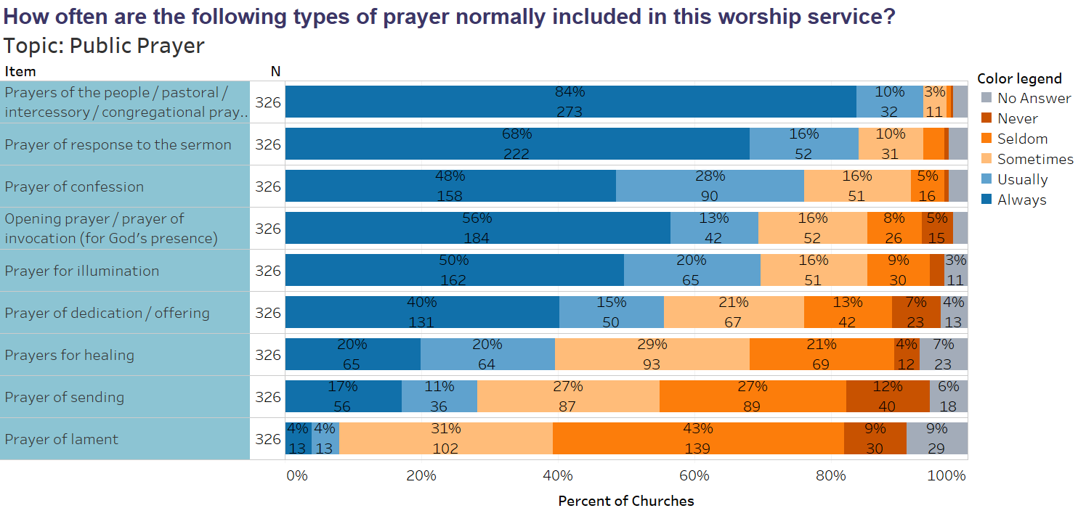
Notes:
Again, if we ask the same question again in the future we may see some trends. Are we praying more or less often in our churches? I was surprised to see that only 84% of our churches include a pastoral prayer in their morning worship where the needs and praises of congregational members, the church, our communities, and the world are raised. If we don’t model such prayer in our worship how will that impact the prayers of our people the rest of the week? As well, over 50% of our congregations never or seldom include prayers of laments. If we can’t bring our laments to God in our corporate worship how will we know that God cares about them? How will we know that we can bring our laments to God in our individual worship?

Slide 42
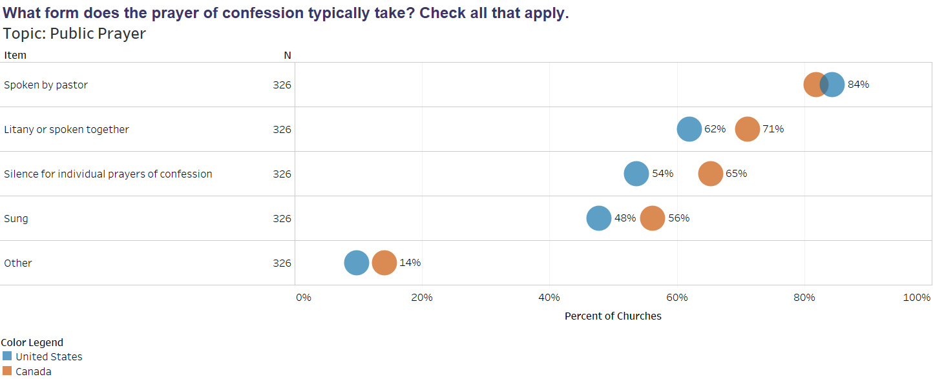
Notes:
Here and in the next slide we see that our churches in Canada seem to involve more people and be a little more creative around worship.

Slide 43
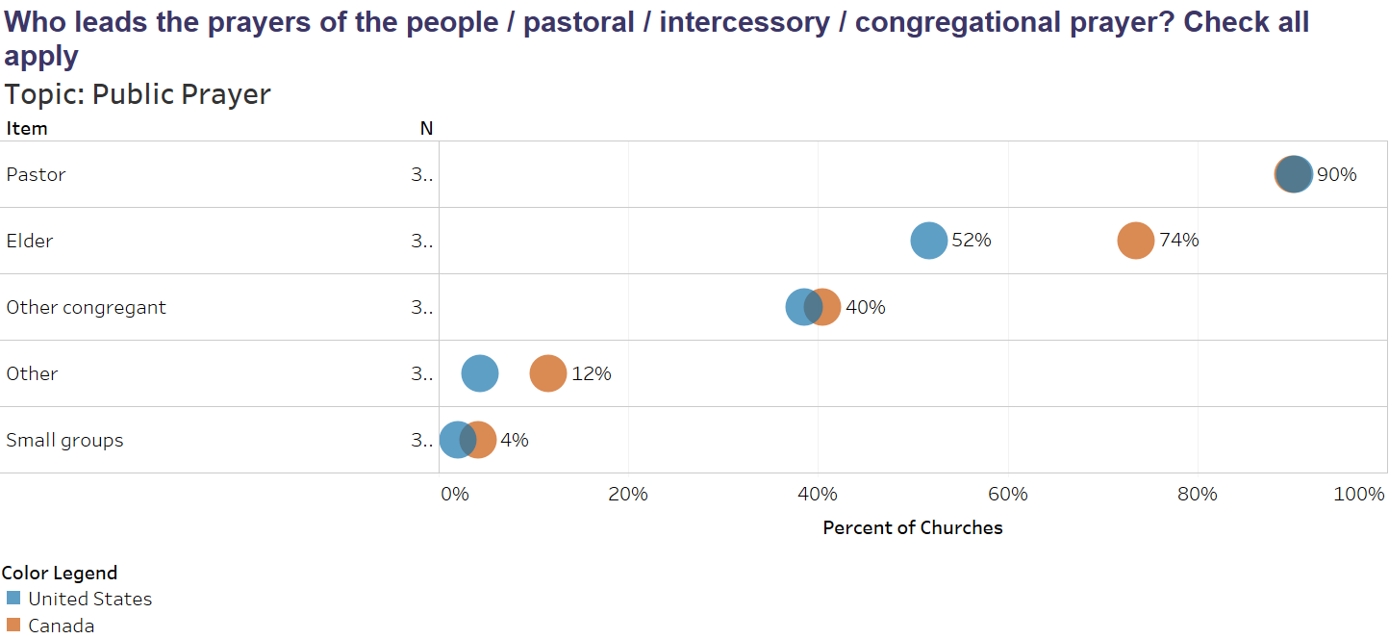
Notes:
Given that in our church order it is our elders who charged with the leadership and oversight of worship. And it is the elders who are also tasked with spiritual leadership of the people I like seeing that they are taking a role in leading prayer in worship.

Slide 44
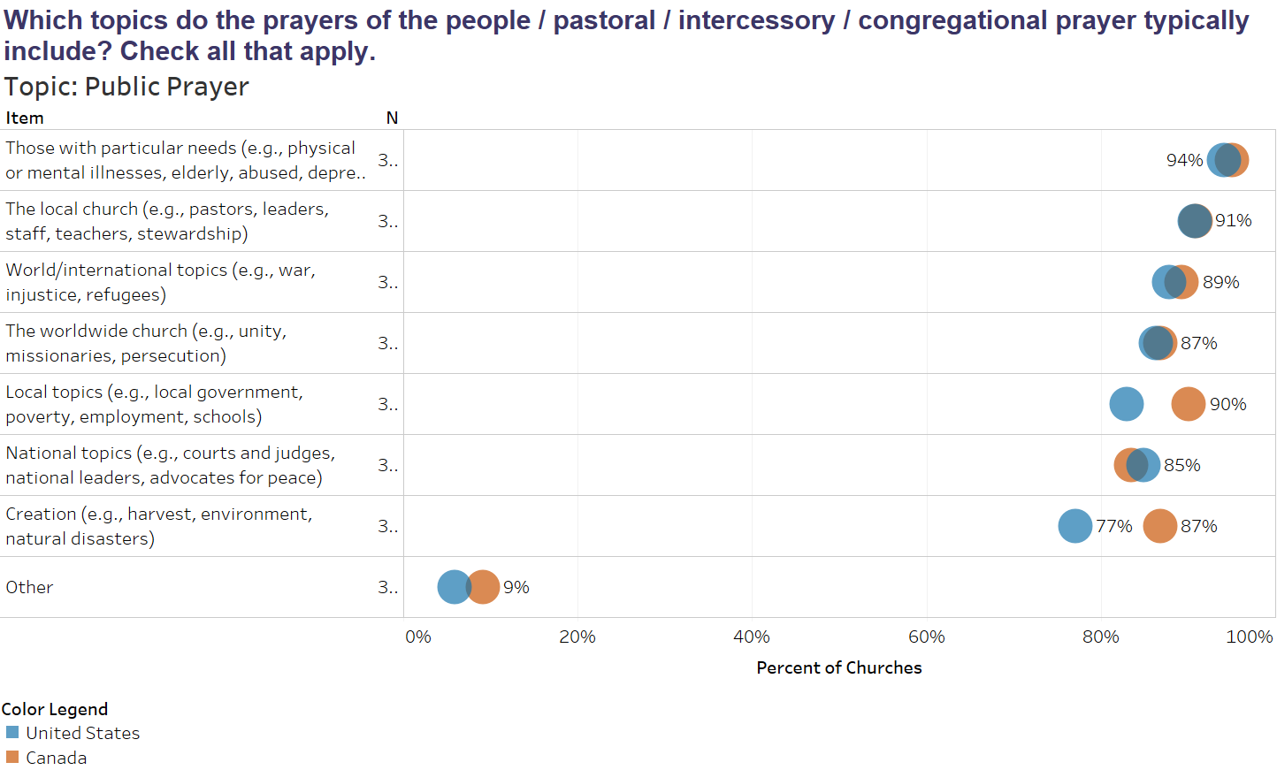
Notes:
Here again we see the difference between our US and Canadian churches, where churches in Canada are more likely to include prayer topics related to the local community and creation.

Slide 45
Notes:
We are a culture that by and large is not comfortable with silence and this plays out in our worship as well. But again it is interesting to note that predominantly non-white churches include silence at a much higher rate. There are many racial/ethnic groups that make up this category and they certainly are not all the same so it shouldn’t be a surprise that this category also sees the largest number of churches that never or seldom include silence.

Slide 46
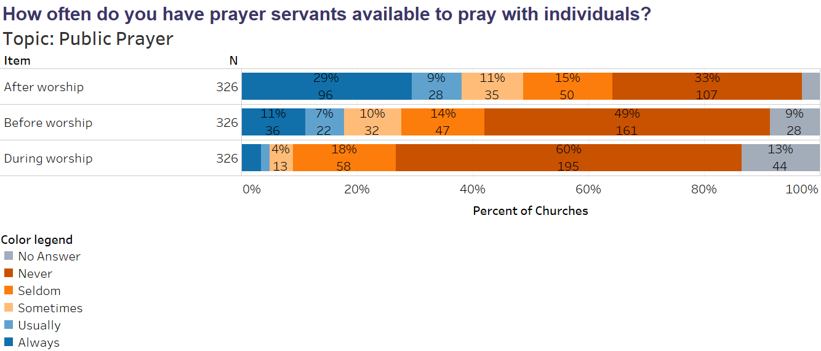
Notes:
This is also a fairly new practice in our churches so it will be interesting to see whether this is a growing trend. What surveys and stats don’t show is the impact that practices like this one may have on our churches pastorally and formationally.

Slide 47
2018 Worship Survey
CRCNA Results
Notes:
Questions?

Slide 48
Other Liturgical Elements and Practices
CRCNA Results

Slide 49
 | 1999 | 2018
How often is there a Confession of Sin? Always- Usually Sometimes Seldom Never | 69.6 | 75
 | 22.6 | 17
 | 7.8 | 4
 |  | 2
Notes:
The next three slides are all in response to this same question and were automatically organized from the most common to the least used elements in worship.
It is interesting to note for example that more churches give a welcome than a Greeting from God. As Reformed Christians who believe that our worship is in response to God’s invitation and that God is already present in our worship this may cause us to pause a moment…
It is very interesting to note that the inclusion of a confession of sin has gone up in our churches.

Slide 50
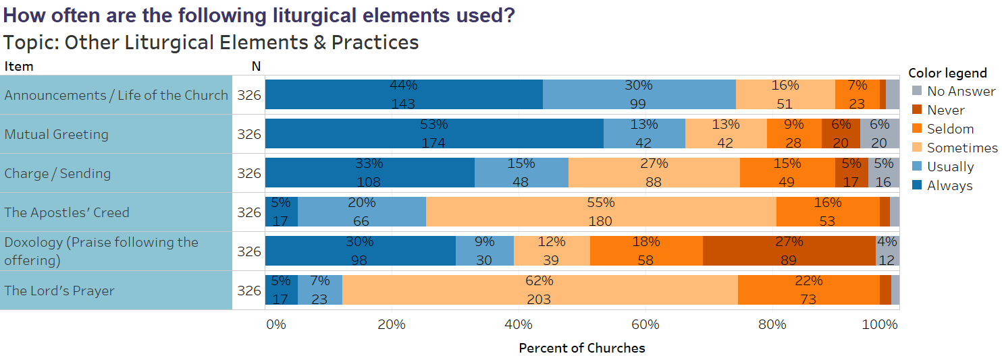
 | 1999 | 2018
How often is the Apostles’ Creed used? Always-Us/Weekly Sometimes/1x month Seldom Never | 94.9 | 25
 | 39.2 | 55
 | 1.6 | 16
 |  | 2
Notes:
In our churches worship you are more likely to hear announcements than you are the Apostles’ or Nicene Creeds, the Lord’s Prayer or the 10 Commandments.
Comparing the use of the Apostles’ Creed in 1999 to today you see that it has gone way done. BUT…we aren’t exactly comparing Apples to Apples. In 1999 the survey was more general over all congregational services and we know that it was pretty normal to say the Apostles’ Creed in the evening service. Whereas in the 2018 survey respondents were asked to focus on just one of their services. Still, given that for many of our churches that one service is the only service that they have, and for those that have 2 services on the Sunday the survey respondents answered for the one most attended many of our congregants do not recite the Apostles’ Creed with great regularity.

Slide 51
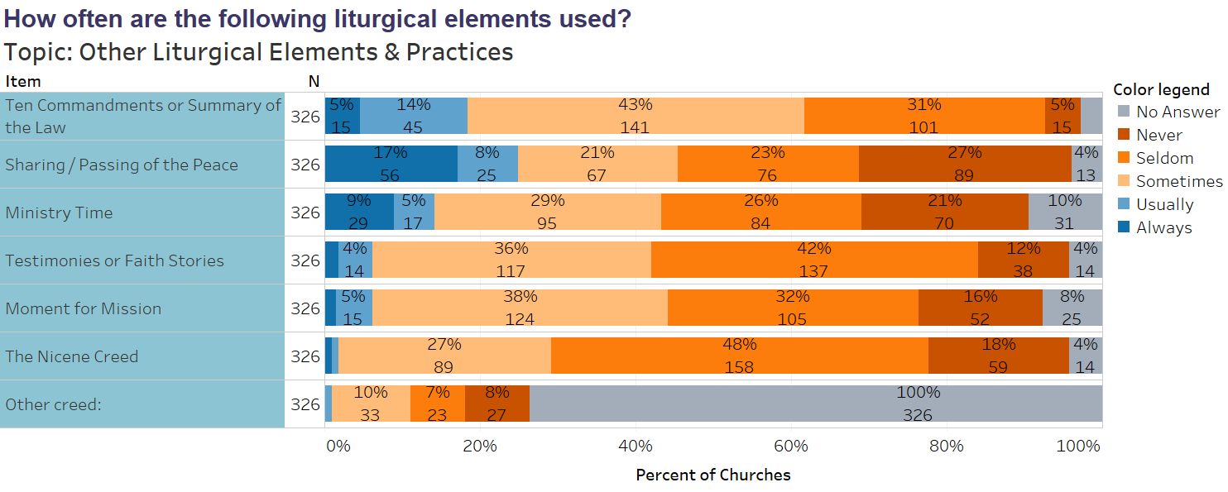
 | 1999 | 2018
How often are 10 Commandments used? Always-Usually/Weekly Sometimes/1x month Seldom Never | 12.5 | 19
 | 38.5 | 43
 | 30.6 | 31
 | 17.4 | 5
 | 1999 | 2018
How often is the Nicene Creed used? Always-Usually/Weekly Sometimes/1x month Seldom Never | .7 | 2
 | 37.8 | 27
 | 72.8 | 48
 |  | 18
Notes:
This I found VERY surprising. When comparing the use of the 10 commandments in 1999 to today we are actually using them more often.
Whereas the number of churches using the Nicene Creed every week has gone up its over all use has gone done.

Slide 52
Notes:
This gives us a peak at some of our other confessions and testimonies and how often they are used. The fact that Our Songs of Hope is as low as it is shouldn’t be surprising to us as it is the RCA’s version of a contemporary testimony and not officially adapted in the CRC, though of course a useful source of liturgical material.

Slide 53
 | 1999 | 2018
How often is the Heidelberg Catechism used? Always-Us Sometimes Seldom Never | 30 | 15
 | 29.1 | 62
 | 12.6 | 18
 |  | 4
How often is the Belgic Confession used? Always-Usually Sometimes Seldom Never | 3.3 | 4
 | 34.5 | 40
 | 62.2 | 37
 |  | 17
How often is the Canons of Dort used? Always-Usually Sometimes Seldom Never | 0 | 3
 | 28.2 | 22
 | 71.8 | 40
 |  | 32
How often is the Contemporary Testimony used? Al-Usually Sometimes Seldom Never |  | 3
 | 36.3 | 49
 | 63.5 | 27
 |  | 17
Notes:
When we compare the use of these confessions and testimonies from 1999 to 2018 we see the following trends.
There are more churches that are seldom or never using the Heidelberg Catechism. –Though again remember that in 1999 they were responding based on all their worship services and in 2018 they were asked to respond based on their main worship service.
The use of the Belgic Confession has increased while the Canons of Dort has remained the same, and the use of the Contemporary Testimony has increased.

Slide 54
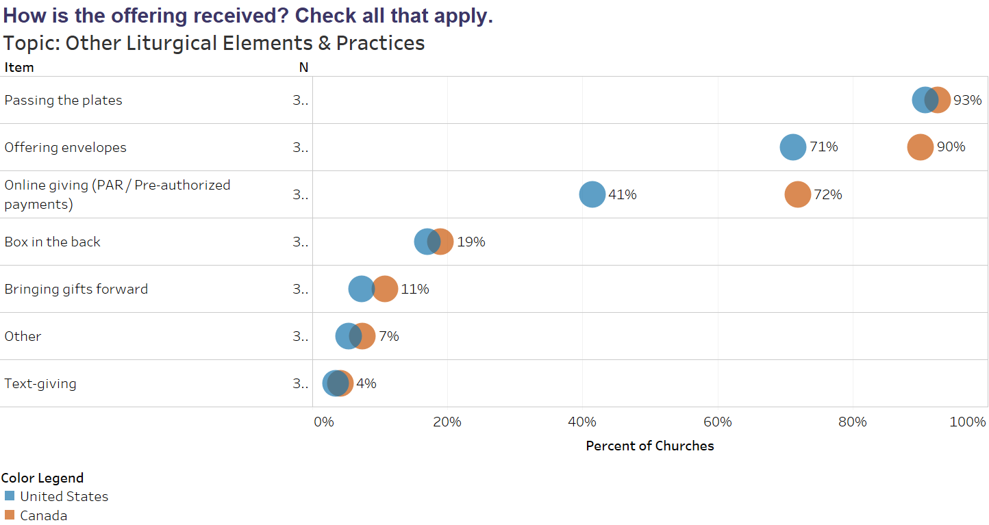
Notes:
I don’t think many of these options were even possible in 1999 so we have nothing to compare this to. It would be interesting to see how this changes even in the next 5 years. But this may be yet another area where we can learn best practices from each other. Is it important that the tithe be given as part of our worship? If so, how can we make that a meaningful part of worship when fewer and fewer worshipers are giving money during that moment in worship?

Slide 55
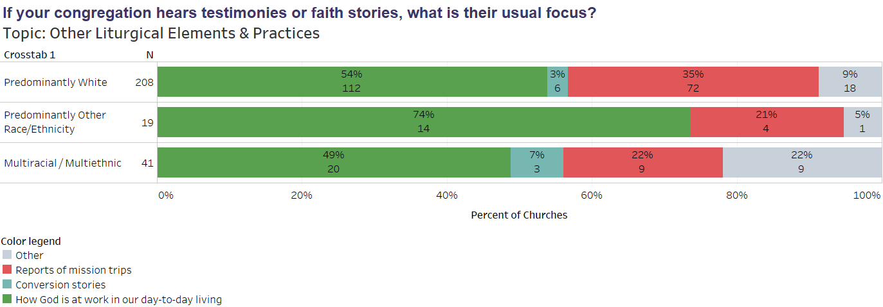
Notes:
One of the desired futures of the CRC is to see more people sharing their faith stories. Not just conversion testimonies but also how God is at work in our day-to-day living.
When asked if they sometimes or always had such faith stories or testimonies less than 50% said they did. This question asks them to choose what the focus of those testimonies usually is. We can see that few of our churches share conversion stories while more share stories of God at work in the world around them or mission reports.

Slide 56
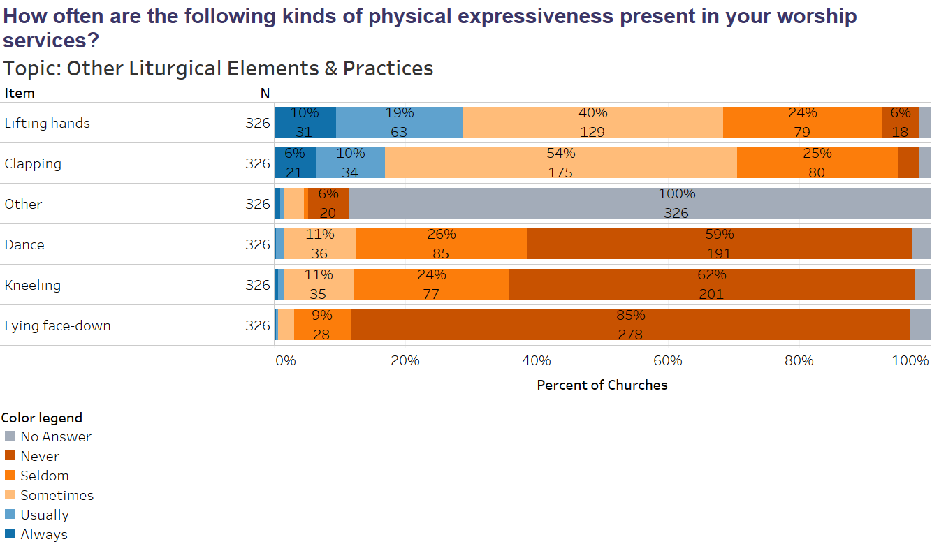
 | 1999 | 2018
Lifting Hands: Always-Usually Sometimes Seldom Never | 16.9 | 29
 | 44.4 | 40
 | 38.7 | 24
 |  | 6
 | 1999 | 2018
Kneeling: Always-Usually Sometimes Seldom Never | 1.8 | 2
 | 8.2 | 11
 | 86.3 | 24
 |  | 62
Notes:
While we may kneel and lift our hands a little more today than in 1999 in general CRC folk are not physically expressive.

Slide 57
Notes:
When you take the predominantly white churches out of the mix things look a little different.
You go from 69% of churches sometimes-always Lifting hands to 80%
Clapping goes from 70% to 86%
Kneeling from 13% to 36%
Dancing from 12% to 28%

Slide 58
2018 Worship Survey
CRCNA Results
Notes:
Questions?

Slide 59
Worship Formation
CRCNA Results

Slide 60
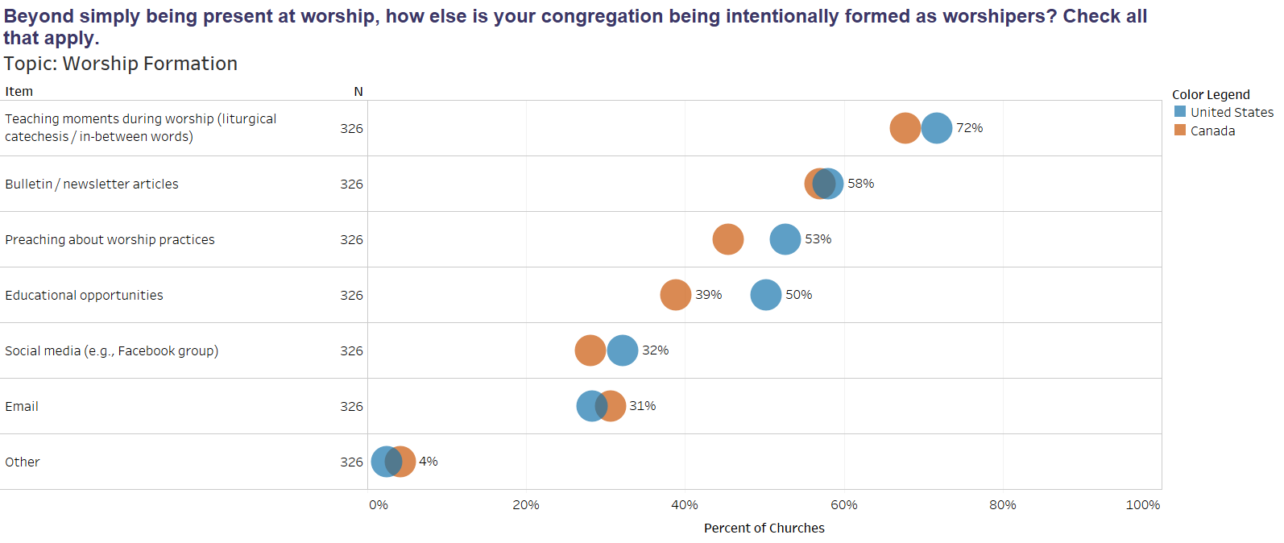
Notes:
Here we asked the question of how or where intentional teaching about worship happens.

Slide 61
Notes:
73% of our churches say that they are forming worshipers through their membership classes. It would be interesting to hear from churches about what that looks like. Do we take the time to walk through and explain all the elements of worship or is it a matter of taking a couple of minutes to read a statement about worship? Are the sacraments explained?

Slide 62
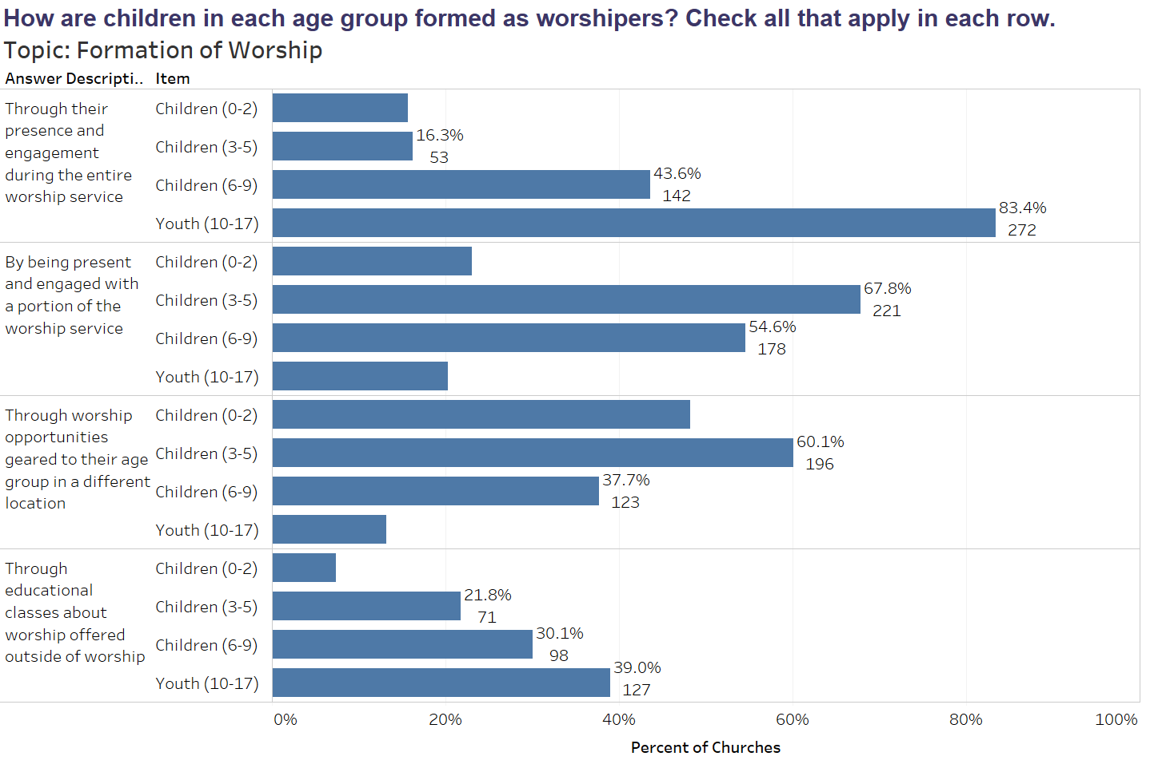
Notes:
How is it that we educate our children about worship and when does that occur?
What is clear is that outside of what happens during the worship time (either with the entire congregation or in a separate location) there isn’t much intentional worship formation or education happening.

Slide 63
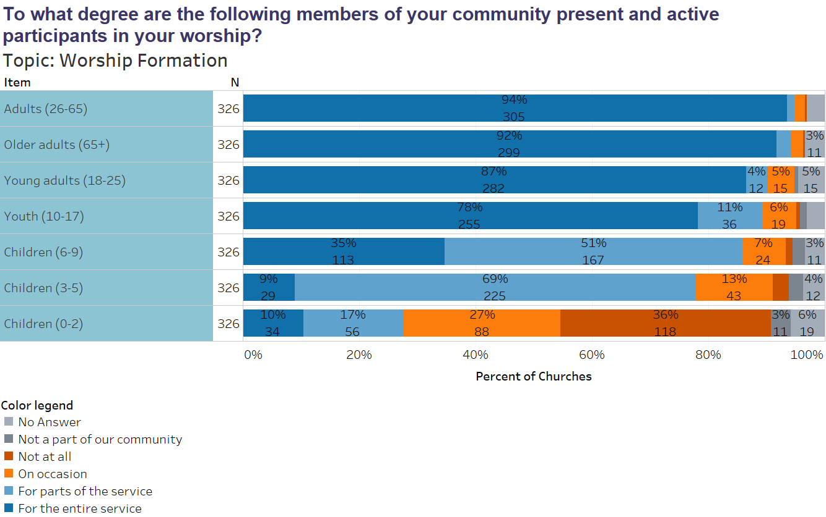
Notes:
This asks a slightly different question. Not whether or not they are being formed but whether they are active participants in the worship service.

Slide 64
 | 1999 | 2018
% of children that stay for the entire service “young children” 0-2 3-5 6-9 10-17 | 21.9
 |  | 10
 |  | 9
 |  | 35
 |  | 78
children who leave for part of the service “young children” 0-2 3-5 6-9 10-17 | 69.4
 |  | 17
 |  | 69
 |  | 51
 |  | 11
% of children who don’t attend at all “young children” 0-2 3-5 6-9 10-17 | 1.4
 |  | 36
 |  | 3
 |  | 1
 |  | 1
Notes:
It is difficult to compare the 1999 survey with 2018 because in 1999 we simply asked the question about “young children” and did not give an age range.
So it depends how you define young as to whether or not there are more or less children staying for the entire worship.

Slide 65
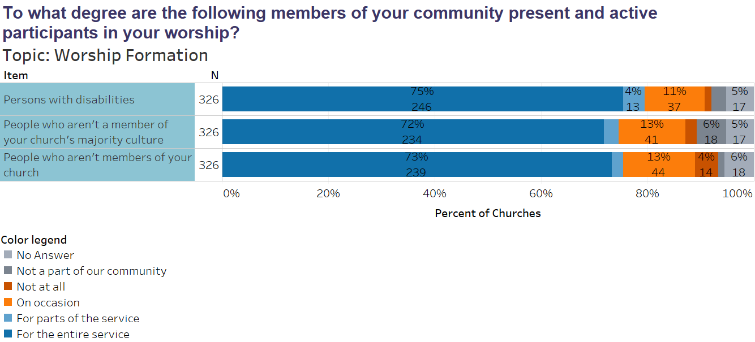
Notes:
This is an interesting question to pause and think through.
11% of our congregations say that persons with disabilities are only present in worship on occasion. That is surprising given the various types of disabilities from learning to physical.
17% of our churches only occasionally or never have visitors.

Slide 66
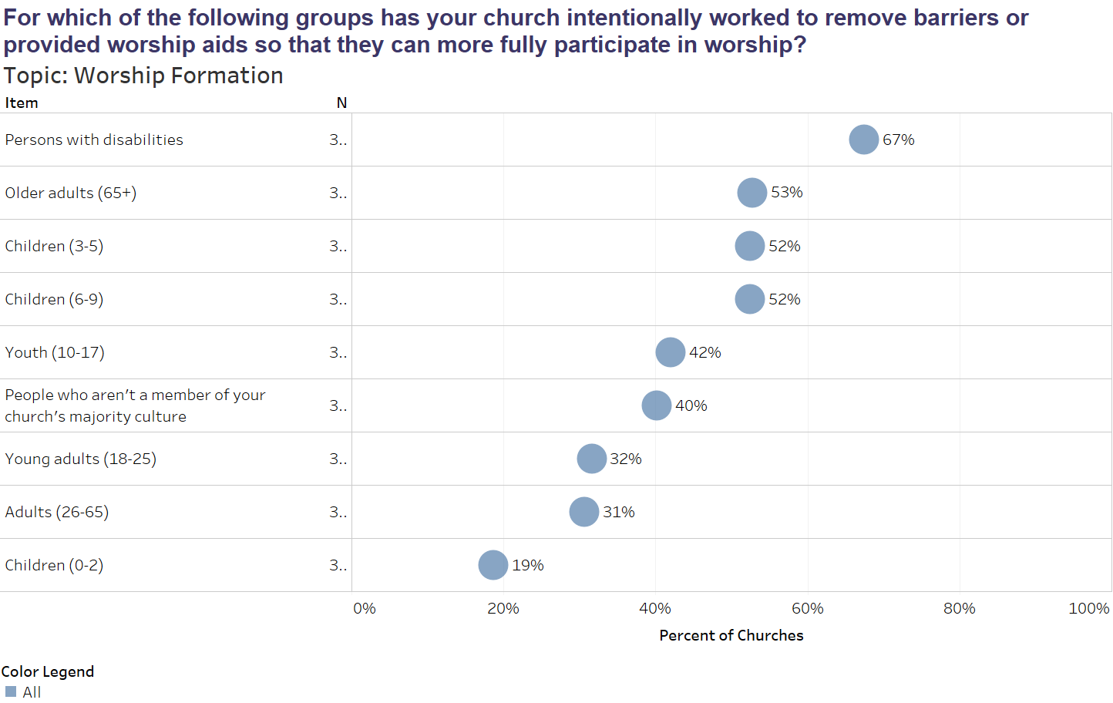
Notes:
It sort of makes sense though that only 75% of our churches have persons with disabilities present for the whole service because only 67% of us have done intentional work to break down the barriers for their full participation.
For each of the populations listed here there are things that we can do to help them be full, conscious, and active participants in our worship. But it takes intentionality.

Slide 67
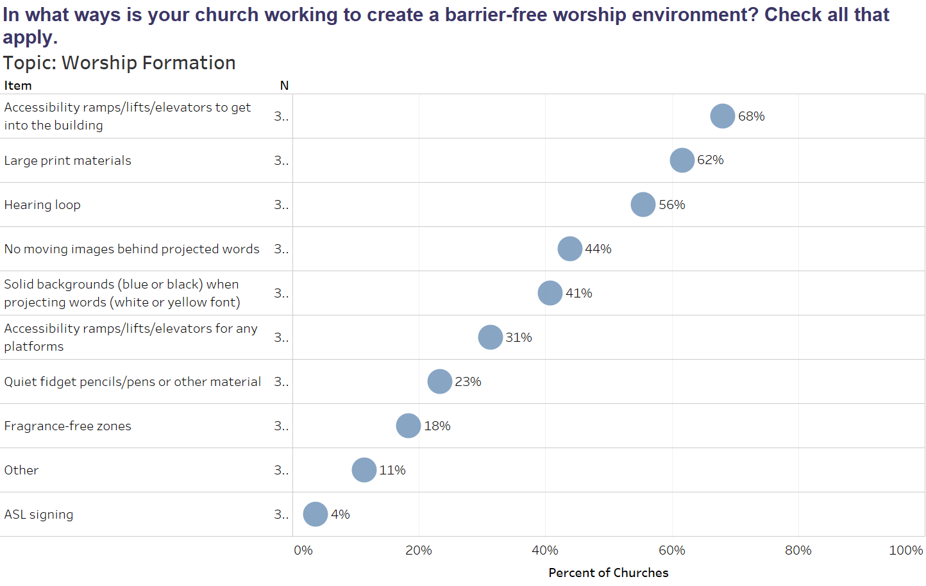
Notes:
What does it communicate to a person who uses a wheelchair that they can never take part in worship leadership, whether it is reading scripture, leading in prayer, or singing with a praise team, because only 31% of our congregations have accessibility ramp/lift/or elevator to the platform?
The interesting thing is that removing barriers of all sorts often brings about a benefit that goes well beyond the intended recipient. For example the accessibility ramp or lift to the main platform may be installed with a particular person in mind but you may find that it is particularly beneficial after your pastor has foot surgery or when the Sunday your member with MS has difficulty negotiating the stairs in order to join the praise team.

Slide 68
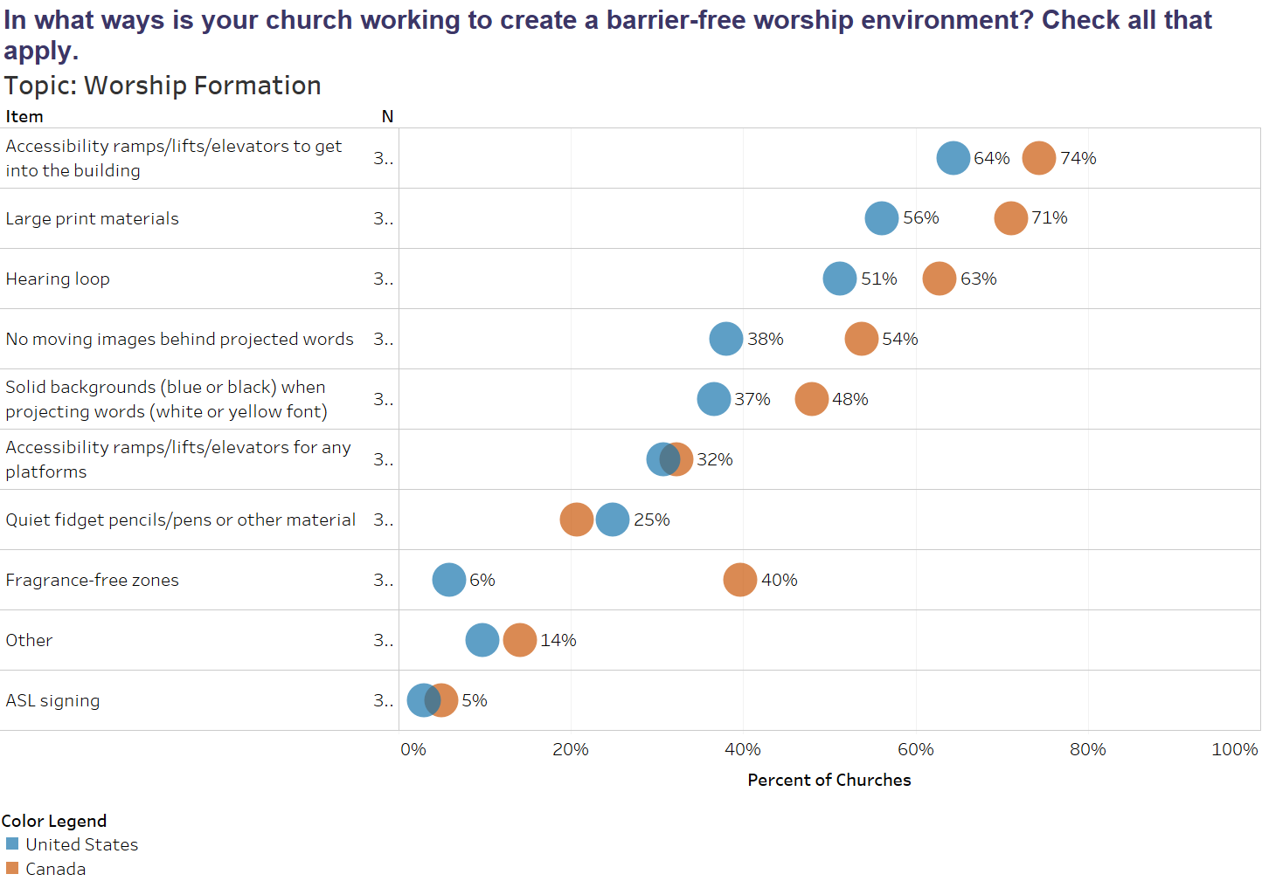
Notes:
Here we see that Canadian churches have done more work to remove barriers than the CRC in the US.

Slide 69
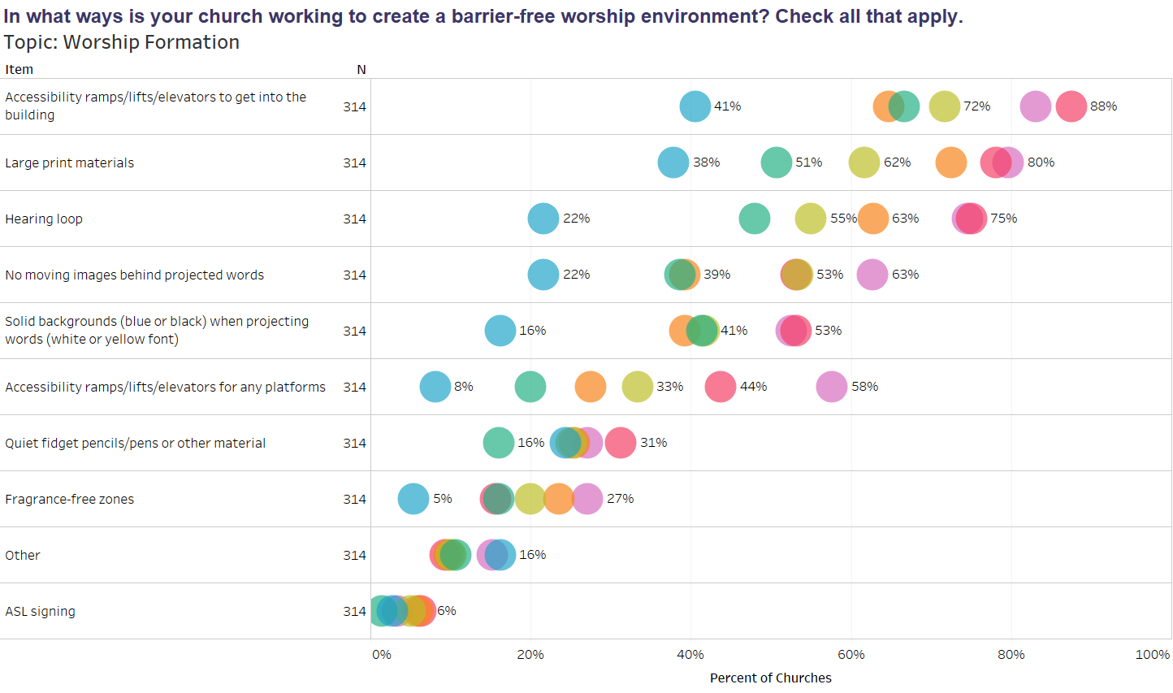
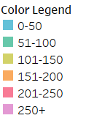
Notes:
And in general larger churches have more financial resources to address some of these issues than smaller congregatons.

Slide 70
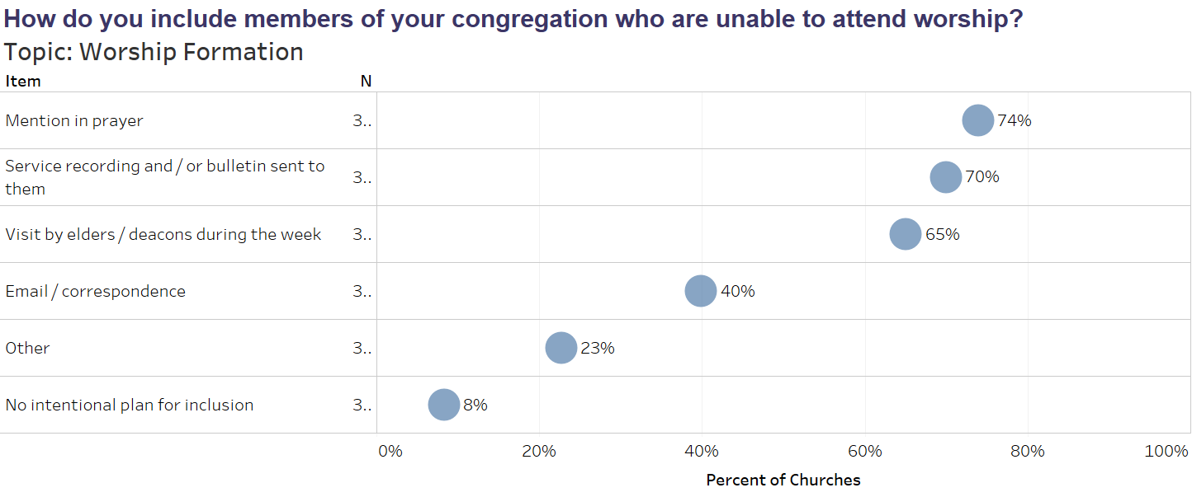
Notes:
But what about those who cannot attend worship at all?
8% of our churches have nothing in place to help them connect with corporate worship.

Slide 71
2018 Worship Survey
CRCNA Results
Notes:
Questions?

Slide 72
Worship Leadership
CRCNA Results

Slide 73
Notes:
These statistics are particularly important in relationship to youth and young adults. 70% have our congregations do not regularly involve youth in worship (by regularly I mean over 50% of the time) 44% don’t have young adult participation.
Here is the thing. All the research that is out there has shown that if you want your kids to attend worship as young adults they need to be involved with worship leadership when they are middle and high schoolers.
For all of us, the fact that there is somehow helping to lead worship regularly who looks like us (age, gender, and race) communicates in a profound way that we are a part of the community, that it is our worship.

Slide 74
Notes:
It is important for us to pay attention to the question of diversity related to worship leadership because having someone helping to lead worship regularly who looks like us (age, gender, and race) communicates in a profound way that we are a part of the community, that it is our worship.

Slide 75
2018 Worship Survey
CRCNA Results
Notes:
Questions?

Slide 76
Planning Process
CRCNA Results

Slide 77
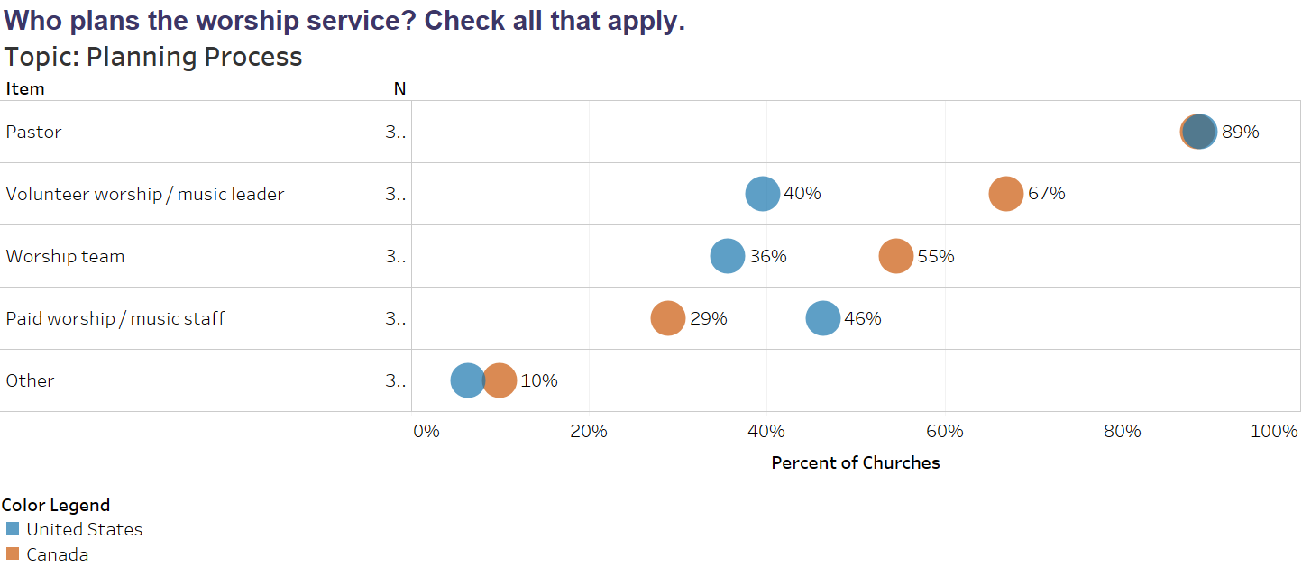
Notes:
It is interesting to note all the people who are involved in the planning of worship particularly the roll of a paid worship/music staff person. We can assume that if you have such a person on staff they would be involved in planning worship, thus you would check that box. Following that logic is seems that only 29% of Canadian churches and 46% of US churches have paid worship/music staff. What we can’t discern from this question is how many hours said staff person works.
When it comes to volunteers, in Canada 67% of churches have volunteers involved with worship planning.

Slide 78
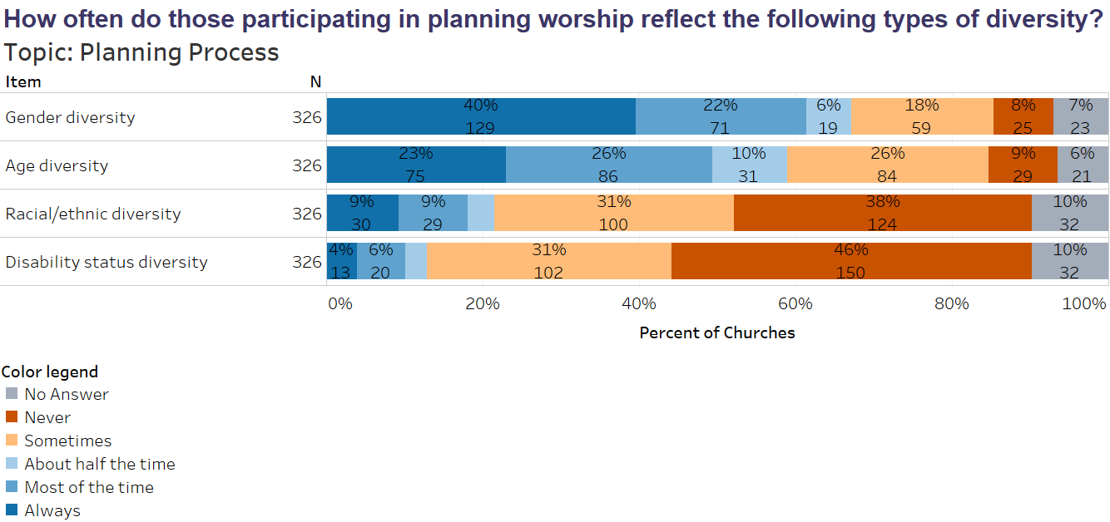
Notes:
Again, if we want worship that connects with diverse populations the best thing we can do is include them in the worship planning process.

Slide 79
Notes:
This question will be an interesting one to watch over time.
On the books the CRC worship structure is 3-fold (Approach/Word (which for us includes the sacraments, and then response).
What concerns me are the number of churches that structure their worship around singing followed by teaching because it fails to reflect the Trinitarian and diaglogical nature of worship that is at the heart of our Reformed understanding of what happens when we gather for worship.

Slide 80
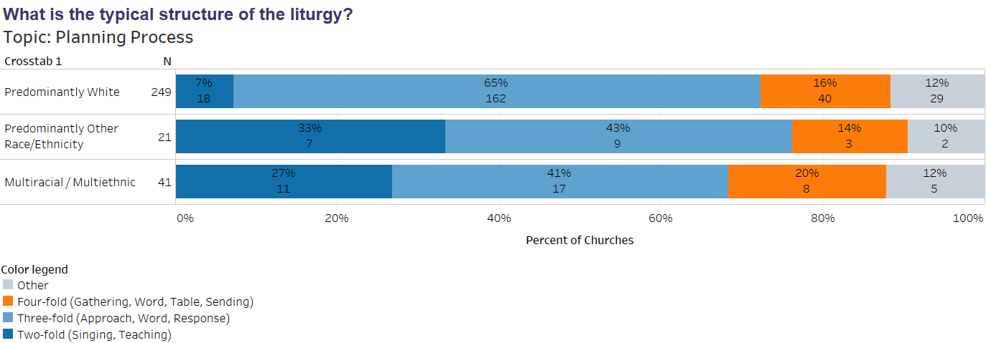
Notes:
Often when people join the CRC and they are asked what drew them to our denomination they say it is the theology. But I wonder if we are doing enough to help people of all backgrounds see the implications of our theology for worship.

Slide 81
Notes:
I think this is interesting to watch, but not of huge concern. In either case, written or extemporaneous, those words can either be influenced by and reflective of a robust Reformed theology of scripture and worship and a Reformed world-and-life view or be influenced by and reflective of other theologies, like that purported by the local Christian radio station, for example.

Slide 82
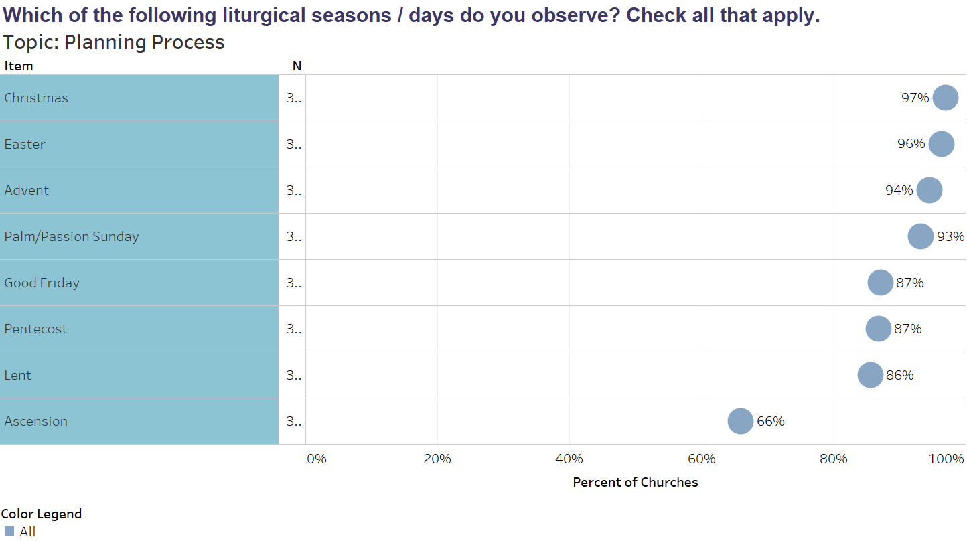
Notes:
Ascension day--- this use to take precedence over advent, lent,
Note: Canadian churches are more likely to celebrate liturgical seasons/days than those in the US except the following: Maundy Thursday, Ash Wednesday, Christ the King, Trinity Sunday, Christmastide, Baptism of Jesus, All Saints, and the Annunciation.

Slide 83
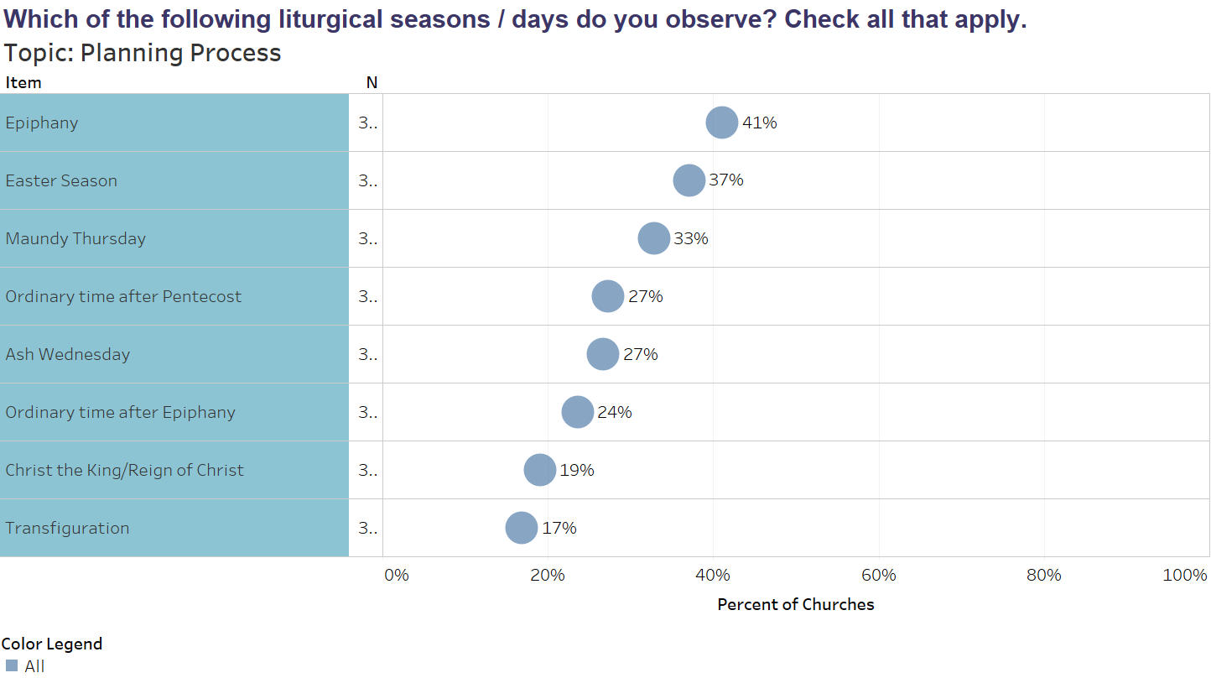
Notes:
Note: Ash Wednesday is twice as likely to be observed by multiracial/ethnic churches,

Slide 84
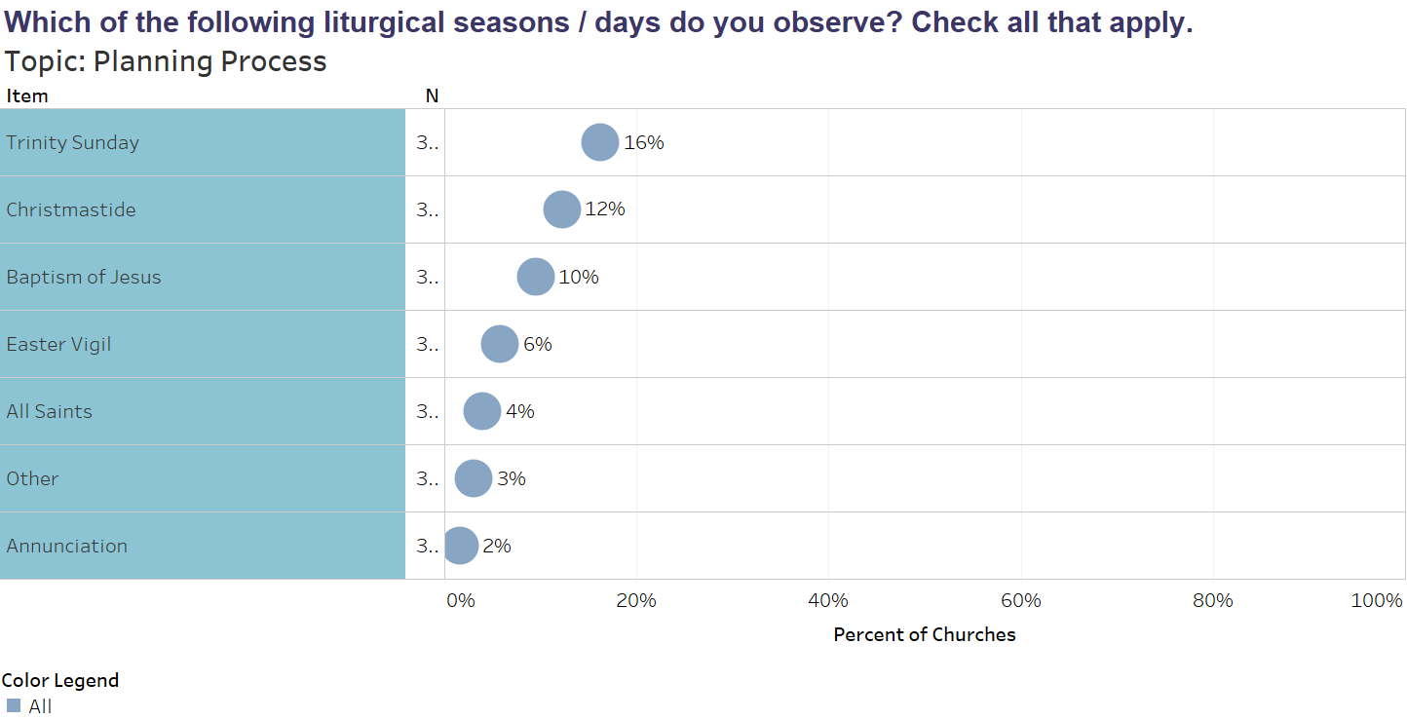
Note: Emerging churches are more likely to observe Ash Wednesday and the Annunication then organized churches.

Slide 85
 | 1999 | 2018
Which of the following liturgical seasons/days do you observe? Christmas Eve Christmas Day Epiphany Ash Wednesday Lent Maundy Thursday Good Friday Easter Vigil Ascension
 | 44 | 97
 | 73.6
 | 8.9 | 41
 | 4.8 | 27
 | 36.7 | 86
 | 35 | 33
 | 76.9 | 87
 | 7.6 | 6
 | 58.5 | 66
Notes:
We are celebrating many more liturgical seasons/days than we did in 1999.

Slide 86
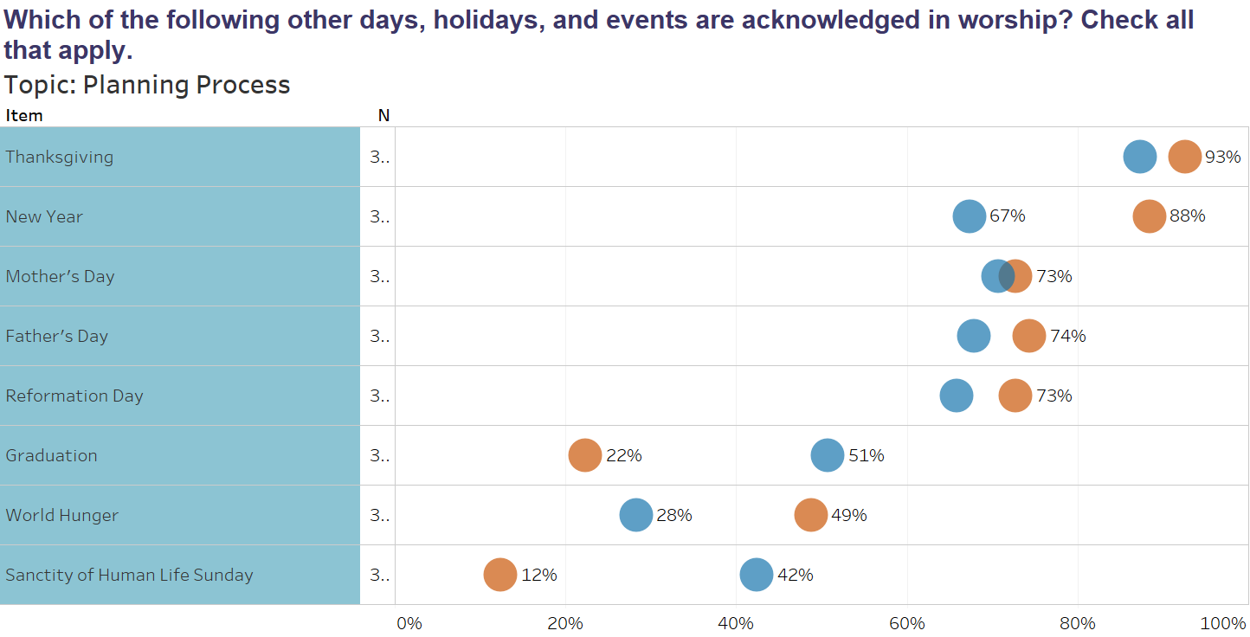
 | 1999 | 2018
Days observed New Year’s Eve New Year’s Day Thanksgiving Reformation Day | 56.6 | 75
 | 37.5
 | 91.6 | 89
 | 42.6 | 68

Slide 87
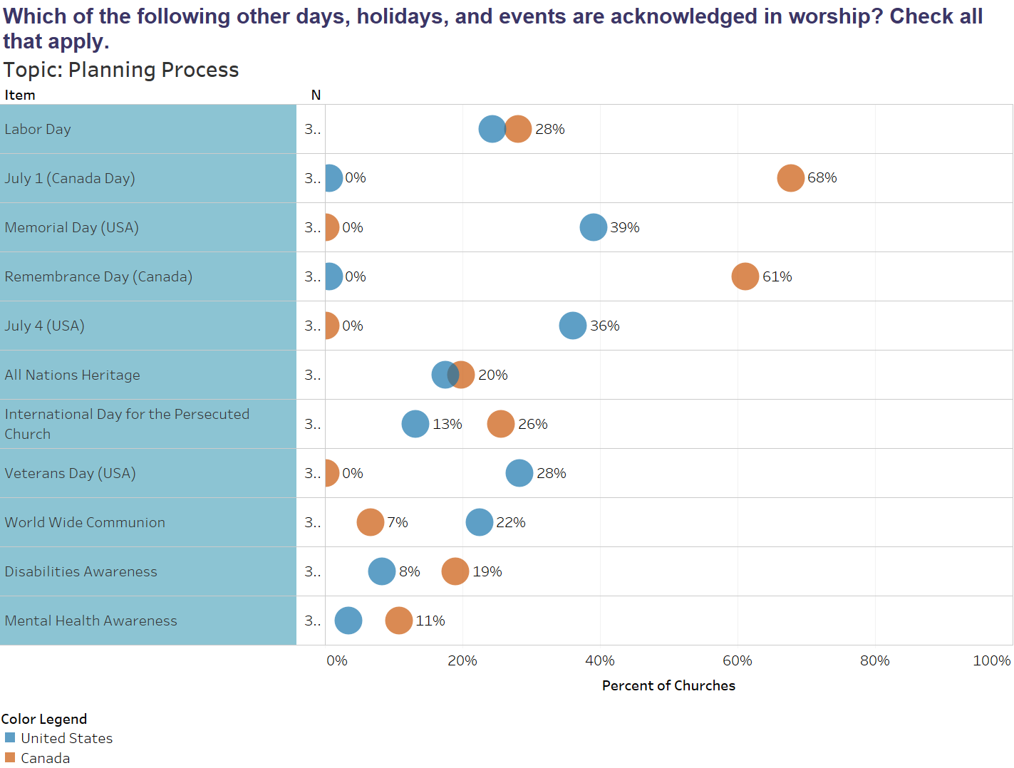
Notes:
It is interesting to note that 68% of churches in Canada commemorate Canada day, while only 36% of the churches in the YS commemorate July 4. Also that Memorial Day is commemorated by more US churches than July 4.

Slide 88
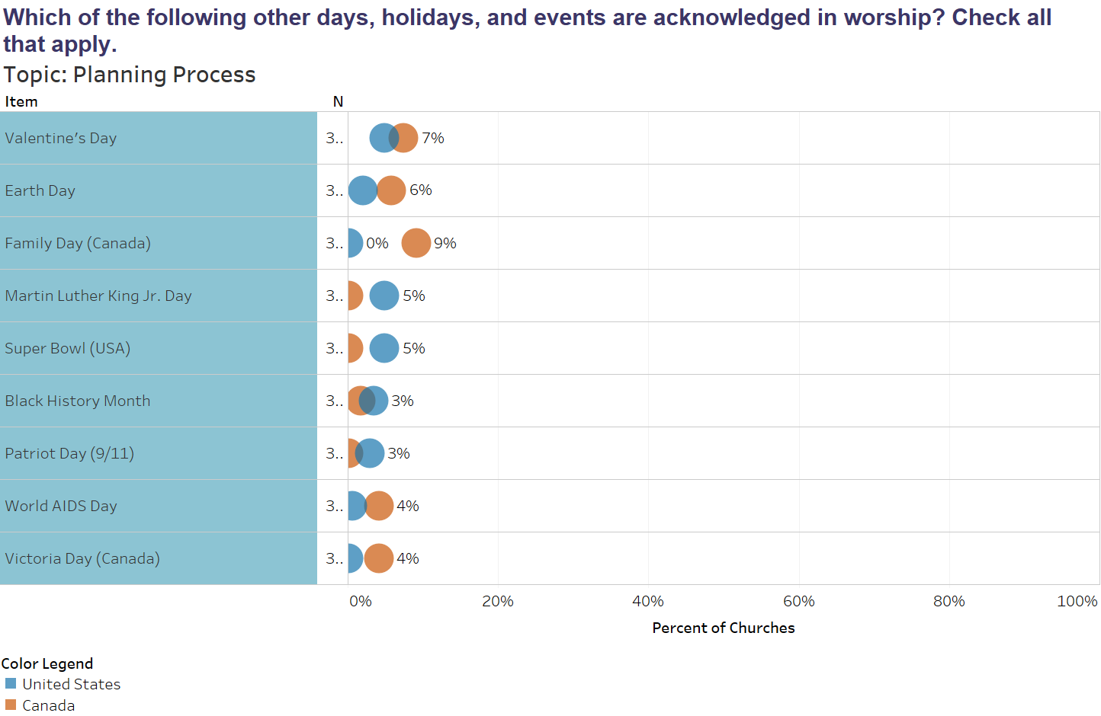

Slide 89
Christmas | 97%
Easter | 96%
Advent | 96%
Palm/Passion Sunday | 94%
Thanksgiving | 87%
Lent | 87%
Pentecost | 84%
Good Friday | 80%
Father's Day | 74%
Mother's Day | 74%
New Year | 69%
Reformation Day | 66%
July 1 (Canada Day) | 66%
Remembrance Day (Canada) | 62%
Ascension | 61%
Memorial Day (USA) | 50%
Epiphany | 46%
Maundy Thursday | 46%
Graduation | 46%
July 4 (USA) | 43%
Easter Season | 42%
Ash Wednesday | 36%
Veterans Day (USA) | 34%
World Wide Communion | 34%
Ordinary time after Pentecost | 32%
Ordinary time after Epiphany | 29%
Labor Day | 28%
World Hunger | 28%
Christ the King/Reign of Christ | 27%
Sanctity of Human Life Sunday | 26%
Trinity Sunday | 25%
Transfiguration | 25%
Baptism of Jesus | 18%
Christmastide | 17%
Martin Luther King Jr. Day | 15%
International Day for the Persecuted Church | 14%
All Saints | 14%
All Nations Heritage | 12%
Disabilities Awareness | 12%
Family Day (Canada) | 11%
Super Bowl (USA) | 10%
Valentine's Day | 7%
Other (Holiday/Event) | 7%
Earth Day | 6%
Mental Health Awareness | 6%
Easter Vigil | 6%
Patriot Day (9/11) | 6%
Black History Month | 6%
Annunciation | 5%
Victoria Day (Canada) | 4%
Other (liturgical Season) | 3%
World AIDS Day | 2%
Cinqo de Mayo (USA) | 1%
Kwanzaa | 1%
Las Posadas | 0%
Notes:
It becomes more interesting when you put the two calendars together…

Slide 90
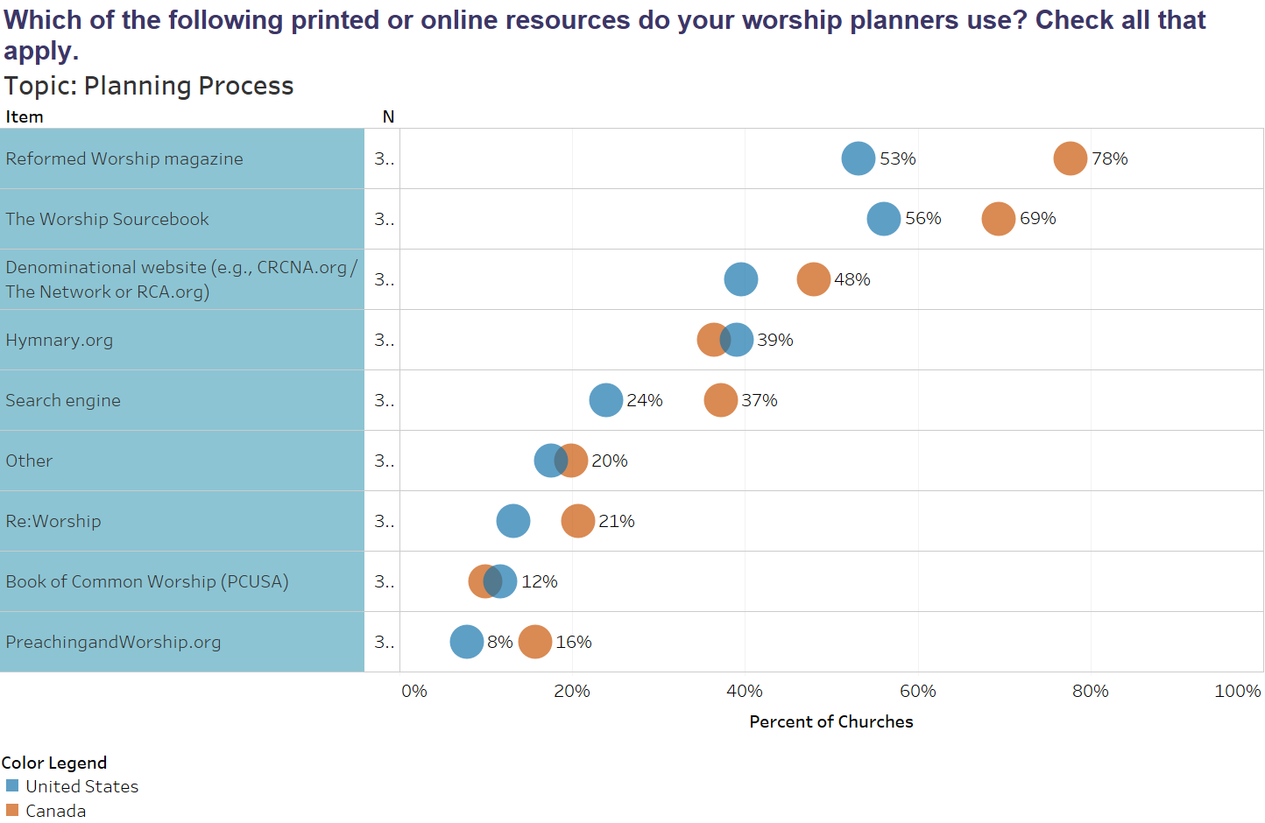

Slide 91
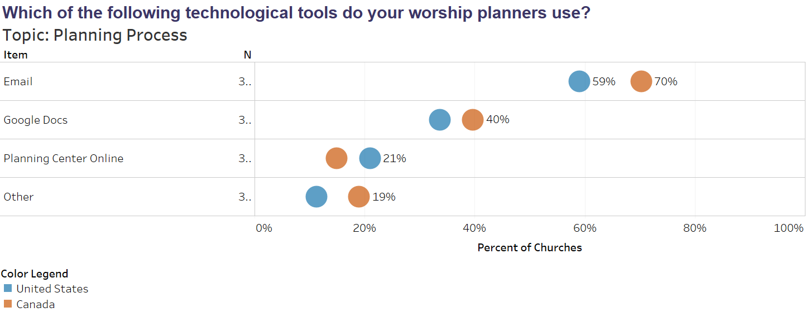

Slide 92
2018 Worship Survey
CRCNA Results
Notes:
Questions?

Slide 93
Music and Song
CRCNA Results

Slide 94
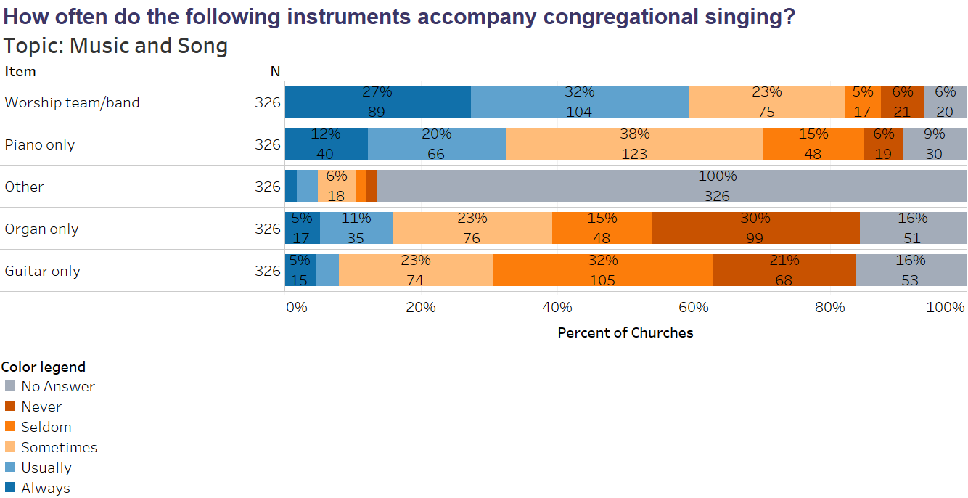
Notes:
Not surprisingly more churches are using a worship team than we had previously.
The piano is used as a solo accompaniment more often than the organ. And there is very little difference between organ usage in the US vs. Canada.

Slide 95
 | 1999 | 2018
Organ accompaniment Always Usually Sometimes Seldom Never | 20.6 | 5
 | 47.5 | 11
 | 14.5 | 23
 | 15.4 | 15
 |  | 30
piano accompaniment Always Usually Sometimes Seldom Never | 25.4 | 12
 | 30.1 | 20
 | 38.7 | 38
 | 5.8 | 15
 |  | 6
Worship team accompaniment Always Usually Sometimes Seldom Never | 12.6 | 27
 | 10.5 | 32
 | 32.3 | 23
 | 44.6 | 5
 |  | 6
Notes:
Here we can see the comparison between 1999 and 2018.
Organ usage has certainly gone down, while the worship team has become more dominant.

Slide 96
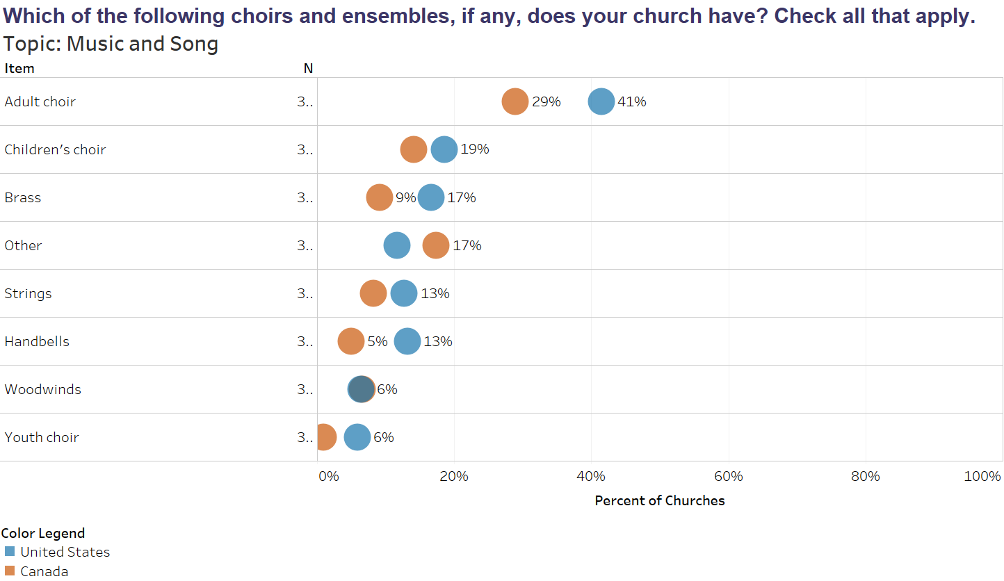
Notes:
Choirs have always had a more prominent place in worship in the US than Canada.

Slide 97
Notes:
Few churches have any ensembles or choirs that participate weekly.

Slide 98
 | 1999 | 2018
Children’s Choir Weekly Monthly Quarterly Yearly Seasonly | 0.2 | 1
 | 14.1 | 3
 |  | 5
 |  | 1
 | 48 | 6
Youth Choir Weekly Monthly Quarterly Yearly Seasonly | 0.6 | 0
 | 8.1 | 0
 |  | 2
 |  | 1
 | 27.9 | 1
Adult Choir Weekly Monthly Quarterly Yearly Seasonly | 9.8 | 6
 | 25 | 8
 |  | 4
 |  | 3
 | 36.2 | 14
Notes:
This chart shows how the inclusion of choirs in worship has diminished from 1999 to 2018.

Slide 99
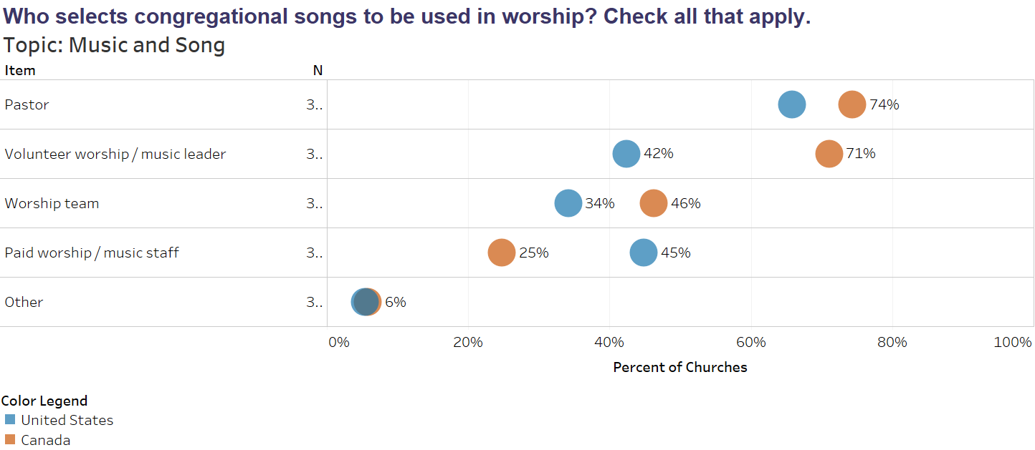
Notes:
This is a similar question to who plans worship but shouldn’t be confused.
In Canada pastors are involved with planning 87% of the services but only 64% select music.
In the US 91% are involved in planning with 74% involved with music selection.
In Canada and the US volunteers are more involved with choosing congregational song than they are with worship planning.
This is significant to note because much of our learned and remembered theology comes from the songs we sing as a congregation.

Slide 100
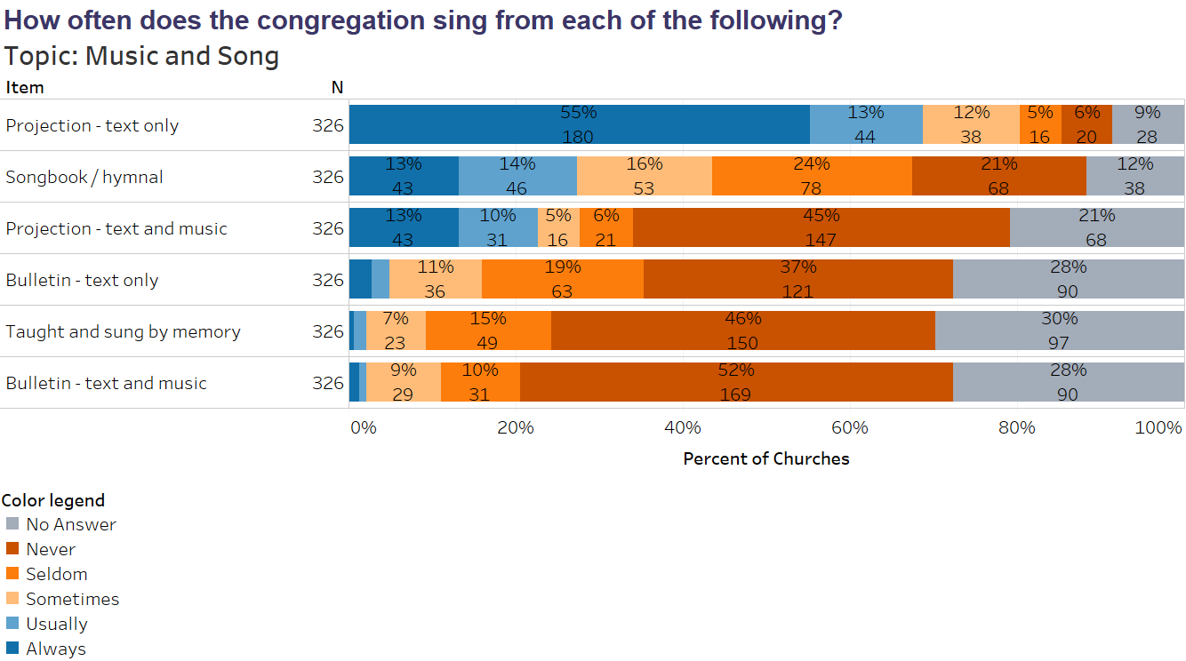

Slide 101
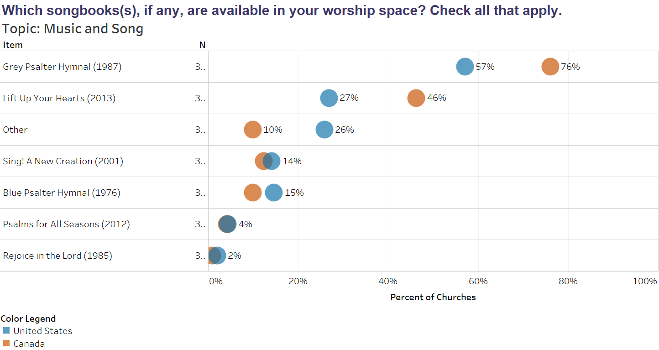
 | 1999 | 2018
Use the Psalter Hymnal (87) and LUYH | 89 | 64 PsH 34 LUYH
Notes:
It should be noted that just because they are available does not mean that they are used or indicate how often. But still, given that LUYH is just 6 years old the likelihood of it being in the pew but not ever used is slim. It warms my heart to see that it is available in 46% of Canadian churches and 27% of US churches. The goal was for it to be in 20% of our churches. Psalms for All Seasons which came out about 7 years ago was never intended for the pew but yet 4% of our congregation do have it available.

Slide 102
Notes:
In addition we see that hymnals continue to be a prime resource for what songs appears on the screen.

Slide 103
 | 1999 | 2018
A.7 Songbook/Hymnal Always Usually Sometimes Seldom Never | 34.9 | 13
 | 42.6 | 14
 | 11.5 | 16
 |  | 24
 | 11.1 | 21
A.7 Projection -text and music/overhead Always Usually Sometimes Seldom Never | 2.7 | 13
 | 4.8 | 10
 | 14.7 | 5
 |  | 6
 | 77.8 | 45
A.7 Projection -text only Always Usually Sometimes Seldom Never | 28.5 | 55
 | 21.4 | 13
 | 20.5 | 12
 |  | 5
 | 29.6 | 6
 | 1999 | 2018
A.7 Bulletin -text and music Always Usually Sometimes Seldom Never | 2.8 | 1
 | 5.2 | 1
 | 41.7 | 9
 |  | 10
 | 30.2 | 52
A.7 Bulletin -text only Always Usually Sometimes Seldom Never | 8.8 | 3
 | 13.5 | 2
 | 47.5 | 11
 |  | 19
 | 30.2 | 37
Notes:
Again, doing a quick comparison with 1999 we see that hymnal usage has diminished and projection is more common.
So much has changed since 1999 when churches were still using overheads as a means of projection.

Slide 104
Notes:
Most of our congregations have a CCLI license but since that doesn’t cover any of the music from Tazie, Iona, or GIA, some have opted to get a OneLicense as well.

Slide 105
Notes:
But there are barriers to projection. Again, 20% of our churches do nothing to accommodate those for whom projection is an issue, while others provide large print handouts and a very slight number provide an electronic device so that the font can be adjusted to suit the needs of the user.

Slide 106
2018 Worship Survey
CRCNA Results
Notes:
Questions?

Slide 107
Worship Space
CRCNA Results

Slide 109
 | 1999 | 2018
Is the table always/usually present? | 86.6 | 83
Is the font always/usually present? | 81.3 | 70
Is the pulpit always/usually present? | 84 | 87

Slide 112
 | 1999 | 2018
Have banners | 85.9 | 76
Have paraments | 23.3 | 37

Slide 116
2018 Worship Survey
CRCNA Results
Notes:
Questions?

Slide 117
Technology
CRCNA Results

Slide 118
Notes:
Our churches are increasingly reliant on tech.

Slide 119
Notes:
Smaller churches tend to be less dependent on electronic projection than larger ones. Which leads one to wonder, as our churches get smaller what role will technology have?

Slide 120
Notes:
Churches typically use projection for song lyrics (without musical notation) and litanies.

Slide 121
Notes:
Churches are beginning to do live-streaming but because of copyright issues with the music for many it is only the sermon that is recorded and stored.

Slide 122
Notes:
Our churches do seem to utilize Facebook which makes sense but Millennials and Gen Z tend not to utilize that platform.

Slide 123
2018 Worship Survey
CRCNA Results
Notes:
Questions?

Slide 124
Demographics and Denominational Questions
CRCNA Results

Slide 125
Notes:
It will be interesting to see if what happens language wise as our denomination becomes more diverse. I heard once that every Sunday worship in the CRC occurs in 14 different languages.

Slide 126
Notes:
Desired Future: Vibrant communities, radiating grace, welcoming, nurturing, strengthening, and encouraging” of people of all ages, ethnicities, genders, and abilities in order that all might “grow in the likeness of Christ”.

Slide 127
Notes:
Very interesting… It seems that non-white and multiracial/ethnic churches feel that they are doing a better job at embodying the denomination’s desired future than the predominant culture.

Slide 128
Notes:
As the editor of Reformed Worship, this slide warms my heart (-:
As Worship Ministries we are eager to see the number increase as more we connet with more worship planners and leaders and they find out about the resources available. But we also desire to make sure that whatever our energy is thrown at really does meet the needs of our churches.

Slide 129
Notes:
Worship Ministries is certainly grateful for the support we receive from individuals and congregations. Ministry shares do not cover the budget for any of our ministries. These offering schedules and the resources created for them are one way that we can connect directly with those in the pew.

Slide 130
Notes:
This Bridge is being rolled out in Canada at the moment, so if you are in the US and haven’t heard about it don’t worry. But it does make us wonder and dream about the possibilities for connecting worship resources with that app or something similar.

Slide 131
2018 Worship Survey
CRCNA Results
Notes:
Questions?

Slide 132
2018 Worship Survey
CRCNA Results
Worship@crcna.org
1-877-272-6202
crcna.org/worship
ReformedWorship.org
Notes:
THANKS!
There were many more questions than we could look at today and we didn’t have time to sit an reflect for long. So please, if you have a follow up question that didn’t get answered feel free to email worship@crcna.org and we will get back to you or give us a call.

