Slide 1
Criminal History and Involvement in the Church
Yvonne Lammers, MSW and Patricia Van Reenen, MSW
Safe Church Reps.

Slide 2
Risks in allowing an offender to attend church without a defined Plan:
1. Re-offend
2. Cause uncomfortable/strong feelings (example: parents; trigger intense emotions for anyone with history of abuse)
3. Liability to a church – once Council is aware there is a duty to respond
4. Creates an environment of secrecy and fuels gossip
Notes:
Re-offend – no boundaries in place, no accountability for individual, sets them up in a climate where risk of reoffending is higher;

Slide 3
Three Ways A Church Can Respond:
1. Do nothing
2. Exclude someone from attending
3. Conditional Attendance Policy/ COVENANT OF CONDUCT

Slide 4
TENSIONS
“There is going to be a tremendous urge on the part of church leaders (and church members) to show mercy, forgiveness, restoration, giving a second chance. This is understandable and those are Biblical Principles”
However there are “counter-vailing Biblical principles of justice and the protection of the innocent.”
(https://network.crcna.org/safe-church/criminal-sexual-history-and-involvement-church-supplemental-resources)
Notes:
In making decisions on how to proceed when getting information, there is going to be a tremendous urge……Can’t proof text, pull out specific verses, need to look at the whole picture and recognize that the top principles of mercy and forgiveness and the bottom principles of justice and protection - can be one and the same ; it can feel “easier” to be either an open congregation or a protective congregation - inclined to one side or the other – open and inviting, or closed and protective; in society openness and protection can be seen as competing values “ as followers of Jesus, the church is called to hold openness and protection in dynamic and creative tension”

Slide 5
Protective versus Open Communities:
‘If anyone causes one of these little ones who trust in me to stumble, it would be better for them to have a large millstone hung around their neck and to be drowned in the depths of the sea.’ Matthew 18:6
Those who are well have no need of a physician, but those who are sick. Go and learn what this means, ‘I desire mercy, not sacrifice.’ For I have come to call not the righteous but sinners. Matthew 9:12-13

Slide 6
Navigating the TENSION between…
Maintaining a safe protective environment, especially for children and those most vulnerable
AND
Creating a welcoming and grace-filled response for those who have offended
HOW DOES THE CHURCH DO BOTH OF THESE THINGS ?

Slide 7
A Community of Support and Accountability
A small group of individuals who genuinely care for the one who has offended
Who commit to “walking alongside” in discipleship, prayer, and maintaining accountability
Two things exist together: Genuine caring relationships and Accountability
Notes:
it can feel “easier” to be either an open congregation or a protective congregation - inclined to one side or the other – open and inviting, or closed and protective; in society openness and protection can be seen as competing values “ as followers of Jesus, the church is called to hold openness and protection in dynamic and creative tension”

Slide 8
A Community of Support and Accountability
Recognizes that the church commits to providing a safe caring environment for all
Recognizes that children are vulnerable and at risk and puts their protection at the forefront
Recognizes that God’s grace extends to all
Allows someone with a criminal history to live in the grace of the church
Includes a COVENANT OF CONDUCT

Slide 9
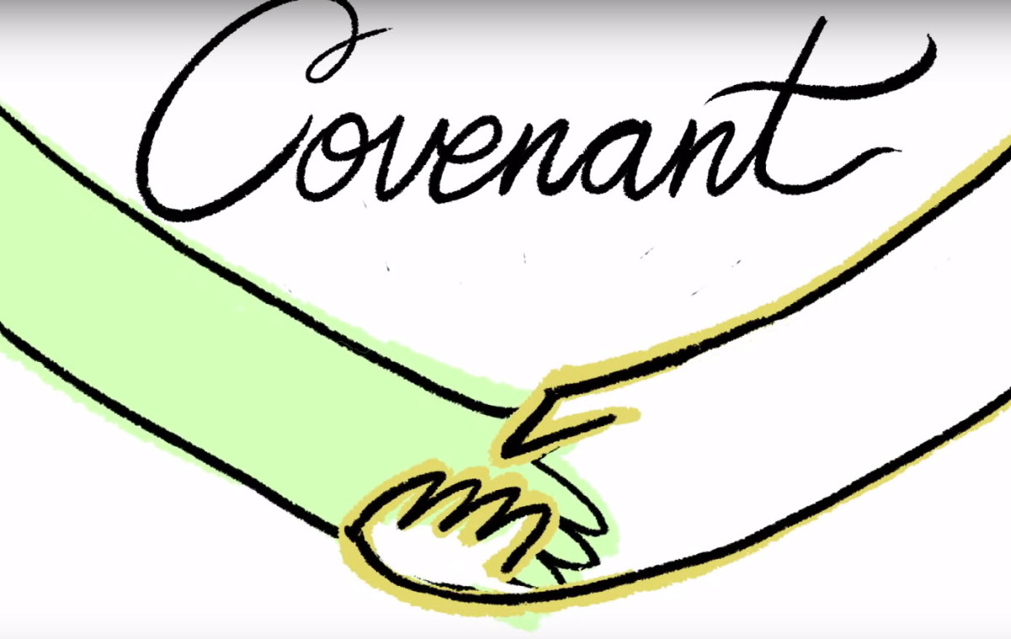
A Covenant of Conduct
1. Establishes actions of the Church to maintain a Caring Environment for everyone
2. Establishes actions/agreements of the covenanter
3. Is discussed and signed by both the Church and Ministry representatives/ and the Covenanter
Notes:
Involved the individual; openness and care for what has happened; valids for individuals; transpancy

Slide 10
COVENANT OF CODUCT INCLUDES:
Supervision
Limitations
Notifications
Noncompliance
Support

Slide 11
What is Forgiveness?
Forgiveness does not mean forgetting. It's normal for memories to be triggered in the future.
Forgiveness is a process, not an event. It will take time to work through our emotional problems before we can forgive. It is a process of letting-go time and time again.

Slide 12
What is Forgiveness?
Forgiveness is not letting the offender off the hook. We can and should hold others accountable for their actions or lack of actions. God commands us to forgive others, and He also calls us to hold each other accountable.

Slide 13
A Process:
Forgiveness starts with a mental decision. The emotional part of forgiveness is finally being able to let go of the resentment.
Letting go of the bitterness while remembering very clearly your responsibility to healthy boundaries.
Notes:
Emotional healing may or may not follow quickly after we forgive.

Slide 14
BOUNDARIES

Slide 15
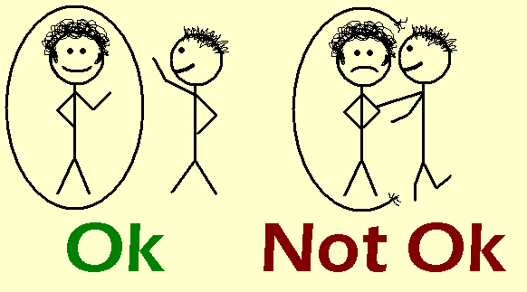
Boundaries:
are a physical or emotional limit that a person defines as safe or appropriate.
are consistent, reliable, and establish that certain behaviors cannot come in or will not go out.
take time and effort to maintain.
are high maintenance for people who have them; people with unhealthy boundaries are high maintenance for others who interact with them.

Slide 16
People with healthy boundaries….
have limits and recognize what they are.
know what they will or will not do.
know what they will allow others to do or not do.
People with unhealthy boundaries….
don’t know what information to share.
trust too easily.
have poorly defined limits.
are overly tolerant of inappropriate behaviors.

Slide 17
Know the difference between Secrecy and Confidentiality:
Secrecy raises suspicion and is unhealthy and encourages
rumours and gossip
Confidentiality means sharing information only with those who need to know in order to maintain the
physical and emotional safety of the
individual or individuals involved in the
situation; all other information is kept
private Eg Duty to inform police,
Children’s Aid Society, physician
Notes:
Example: visiting someone is not a secret; the topics of conversation are private; specifics comments may be confidential. Why should visits not be secret? Who would need to know? Should everything be confidential? Are there exceptions? Harm to self or others. Examples: Secrecy- telling elders or spouse about a visit. Privacy- sharing info with elders and spouse about the general purpose of the visit. Confidentiality- not sharing specific details with other members about the conversation. If confidentiality is going to be broken, let the person know you need to break confidentiality and work out a plan with them.

Slide 18
SEASONS IN THE CHURCH:
Every church experiences the different seasons, including the hard season of Winter which prepares us again for the season of new growth in Spring.
Winter allows for a time of review of policies, a deeper understanding of accountability, and sharing of compassion and empathy.
Often times it is Safe church issues that initiate this season of winter.

Slide 19
Guarding a Sacred Trust:
God is present in every Season.
Churches that have grappled with this Winter season, say that while it was difficult, they drew closer to God.
Churches have to grapple with what they are about, and whether they truly love each other. When there is deep conflict, our love is tested.

Slide 20
Guarding a Sacred Trust:
Church councils require the prayer support and patience of the congregation to make necessary changes in policies, attend additional meetings, and make difficult decisions about the health of the church.
Congregations require transparency and the dedicated follow through of the council to protect the safety of the congregation, especially the young and vulnerable.
The rebuilding of trust requires time for healing.

Slide 21
A Sanctuary Church Is:
A place for all people to find grace
A place where God is present with His people, where His glory is revealed, and His name is honored
A safe place where guarding God’s glory and honour creates tension and requires boundaries
Lord, prepare us, prepare me, to be a sanctuary

