Slide 1
Care Planning and Code status
By Mary Dorencz, NP-c
and Rev. Ben schaefer m.div.

Slide 2
Advanced Care Planning Statistics
Less than 50 percent of Americans living with advanced or terminal illness has a Advanced Directive.¹
There is limited data for percent of all Americans who have an Advanced Directive, but a Pew Research Center survey in 2006 found that only 29 percent of people had a living will.²
¹Kass-Bartelmes BL, Hughes R. Advanced care planning: Preferences for Care at the End of Life. J of Pain & Palliative Care Pharmacotherapy 2004; 18(1): 90
²http://www.people-press.org/2006/01/05/strong-public-support-for-right-to-die/

Slide 3
CPR survey results

Slide 4
Power of Attorney vs. Advanced Directive
Durable Power of Attorney for Health Care is a document that establishes a surrogate decision-maker, which is a legal activity
An Advanced Directive is a document expressing your values, treatment goals and wishes, which is a communications task (often called a living will)
These are often combined into a single document

Slide 5
BARRIERS TO ADVANCE CARE PLANNING
Lack of Awareness
Denial
Confusion
Lack of assistance

Slide 6
Health issues in America
70 percent of Americans (more than 1.7 million) die of a chronic disease (Kung 2008).
About 62 percent of all deaths each year are due to five chronic diseases – heart disease, cancer, stroke, chronic obstructive pulmonary disease and diabetes (Minino 2011).
Alzheimer’s disease is the sixth-leading cause of death across all ages in the United States and the fifth-leading cause of death for those ages 65 and older (Xu 2007).
42 percent of Medicare enrollees age 65 and over have functional limitations (Forum 2010).
25 percent of people receive hospice services at the end of their lives (Casarett 2005).
Advance Care Planning: Ensuring Your Wishes Are Known and Honored If You Are Unable to Speak for Yourself by Carol Tangum, National Association of Chronic Disease Directors

Slide 7
Talking about Code Status
Its always too soon, until its too late

Slide 8
DNR=Do Not Resuscitate=Allow Natural Death
Only applies when the heart/lungs fail or stop
Does not mean “no care”
Patient can receive aggressive/ full medical care

Slide 9
Resuscitation
Comprised of 3 components
1) Defibrillation
2) Chest Compressions
3) Mechanical Ventilation

Slide 10
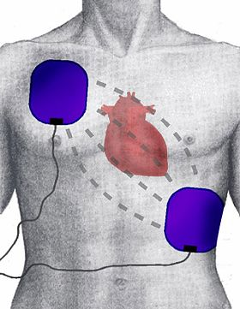
Defibrillation

Slide 11
Chest Compressions

Slide 12
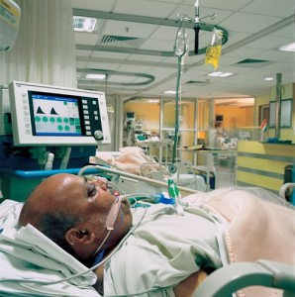
Mechanical Ventilation

Slide 13
Expectations
Study that included all episodes of ER, Chicago Hope and Rescue 911 between 1994-1995.
60 instances of CPR
Mostly traumatic versus primary cardiac/respiratory cause
75% survived initial resuscitation
67% survived to hospital discharge

Slide 14
The Reality
In hospital survival in frail elderly= less than 5%
Advanced chronic disease ( CHF/COPD/Alzheimer disease/Parkinsons Disease) = less than 1%
44% of those who survive, have significant decline in their functional status

Slide 15
Reality part 2
People on mechanical ventilation usually require
Sedation
Restraint
Cannot talk
Cannot eat or drink

Slide 16
Goals at end of life

Slide 17
Goals at End-of-Life
A survey (Steinhauser 2000) of more than 1,400 patients, family members or professionals involved with end-of-life care revealed that their most important goals are:
Pain and symptom management
Preparation for death
Achieving a sense of completion
Decisions about treatment preferences
Being treated as a “whole person”
Advance Care Planning: Ensuring Your Wishes Are Known and Honored If You Are Unable to Speak for Yourself by Carol Tangum, National Association of Chronic Disease Directors

Slide 18
Reducing Conflict
Advanced Care Planning can be a great tool for reducing conflict around end-of-life.
Gives people a voice
Helps people find some measure of control
Helps families come to consensus
Can take some of the stress off of families

Slide 19
Thinking about how you die
How do you approach thinking about death?
Do you think about things you DON’T want?
Do you think about the things you REALLY want?
Today we have both the gift and the curse to set some of our own boundaries (physical and emotional/relational) around what our death could look like.

Slide 20
How to complete a DPOA

Slide 21
Completing a DPOA
First think about what your wishes are and who you trust to be your Patient Advocate
Second talk with this person to make sure they know your wishes and would be willing to honor them.
If possible work through this document with them.
Fill out document.
Sign it in the presence of 2 witnesses who are not related to you, are not named in your document, and are not going to be involved in your health care.

Slide 22
Practice
Take some time and write down some of your wishes about your own care that you would want your loved ones to know if they were the ones speaking for you.
Questions to get you thinking:
under what conditions (if any) would you want to be on a ventilator and for how long?
under what conditions (if any) would you want CPR attempted?
under what conditions (if any) would you want a permanent feeding tube?
What kind of music (if any) would you want playing in your room?
What Are the words that you want your loved ones to know?

