Slide 1
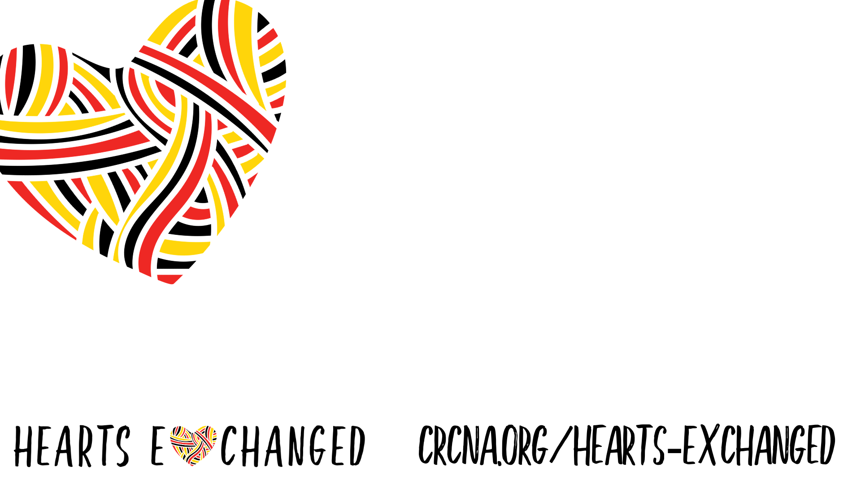
What is Hearts Exchanged?
Hearts Exchanged is a learning and action journey designed to equip Reformed Christians to engage with Indigenous people as neighbours and fellow image bearers.

Slide 2
Who Can Participate?
Anyone connected to the CRC who is wrestling with the challenges and opportunities of reconciliation and open to transformation.

Slide 3
Questions? Sign Up?
More information about this process is available on our website.
Let us know you’re interested in participating on the big participate button.

