Slide 1
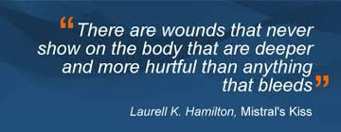
Trauma and the Brain

Slide 3
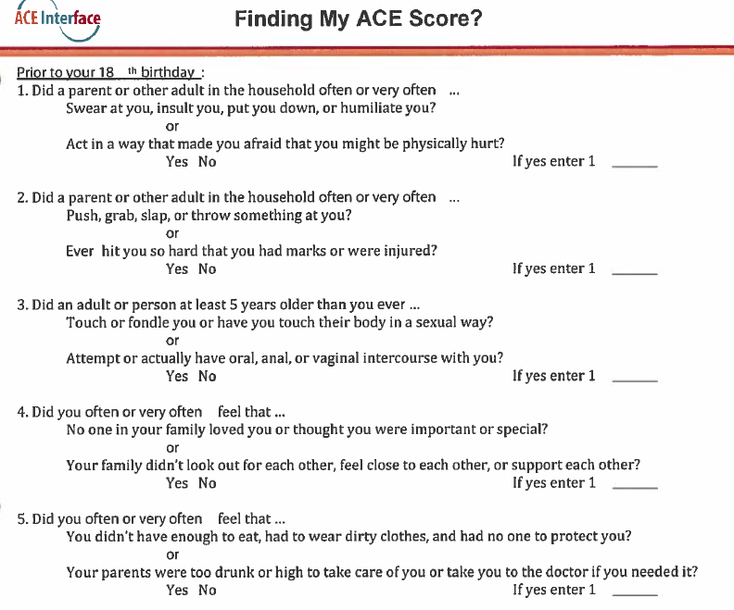

Slide 4
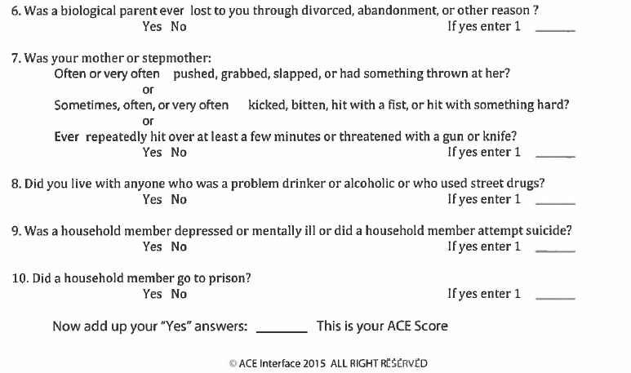

Slide 7
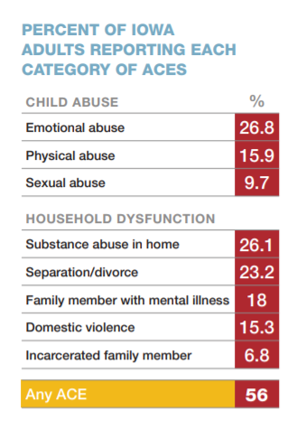
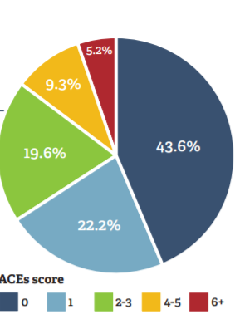
ACE’s 360 Iowa (2015). Beyond ACE’s: Building hope and resilience in Iowa. Retrieved from
file:///C:/Users/tboer/Downloads/acesreport2016_snglpgs-final%20(2).pdf

Slide 9
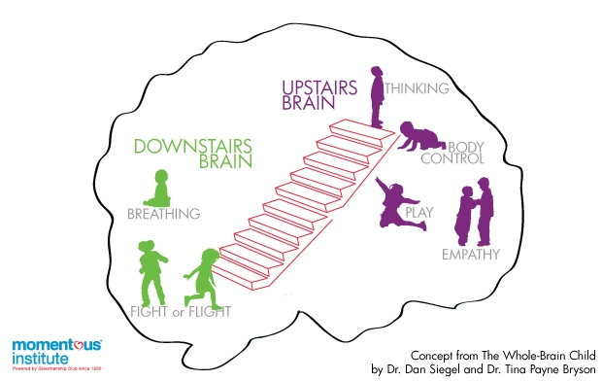

Slide 10
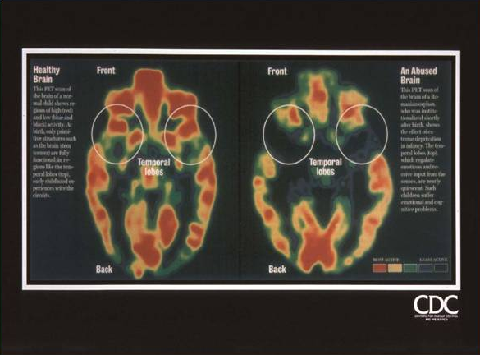
The one on the left is a healthy 3-year-old American boy. The one on the right is a three-year-old Romanian boy who lived in one of the many Romanian orphanages that were known for severely neglecting children, thousands of whom were imprisoned in cribs and rarely given attention.
Notes:
CORTISOL FIGHTS FOR DOPAMINE RECEPTORS
MORE STRESS= Saddness
This is why addicts are most likely to relapse during stress. Stress makes people inherently sad, drugs increase dopamine levels

Slide 11
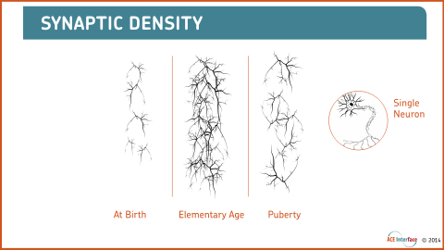

Slide 12
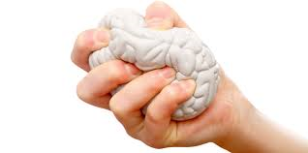
How does stress impact the brain?
Fixated on survival
More excitable neurons
Decreased size of corpus callosum and neocortex
Increased activity and growth in limbic system

Slide 13
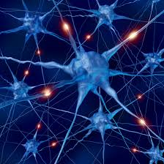
Trauma and Attachment—There’s Hope!
Neurons that fire together wire together
When a child/person becomes disruptive or overly emotional, your response is important!

Slide 14

What can you do?
Connect and re-direct
Name it to tame it (the power of story telling)
Implement a trauma informed lens in the way that you care for people in your ministry
Understand that if someone is feeling overwhelmed emotionally, a logical response wont likely work
Can’t or won’t?
Establish “Felt Safety” which includes warm eyes, healthy touch (if appropriate), soft voice

Slide 15
References
ACE’s 360 Iowa (2015). Beyond ACE’s: Building hope and resilience in Iowa. Retrieved from: https://www.iowaaces360.org/iowa-aces-research.html
Center for Disease Control and Prevention (2020). Adverse Child Experiences (ACE). Retrieved from https://www.cdc.gov/violenceprevention/acestudy/index.html
Siegel D. & Payne-Bryson T. (2012) The whole-brain child: Twelve revolutionary strategies to nurture your child’s mind. Bantam Books, New York.

